Slide 1
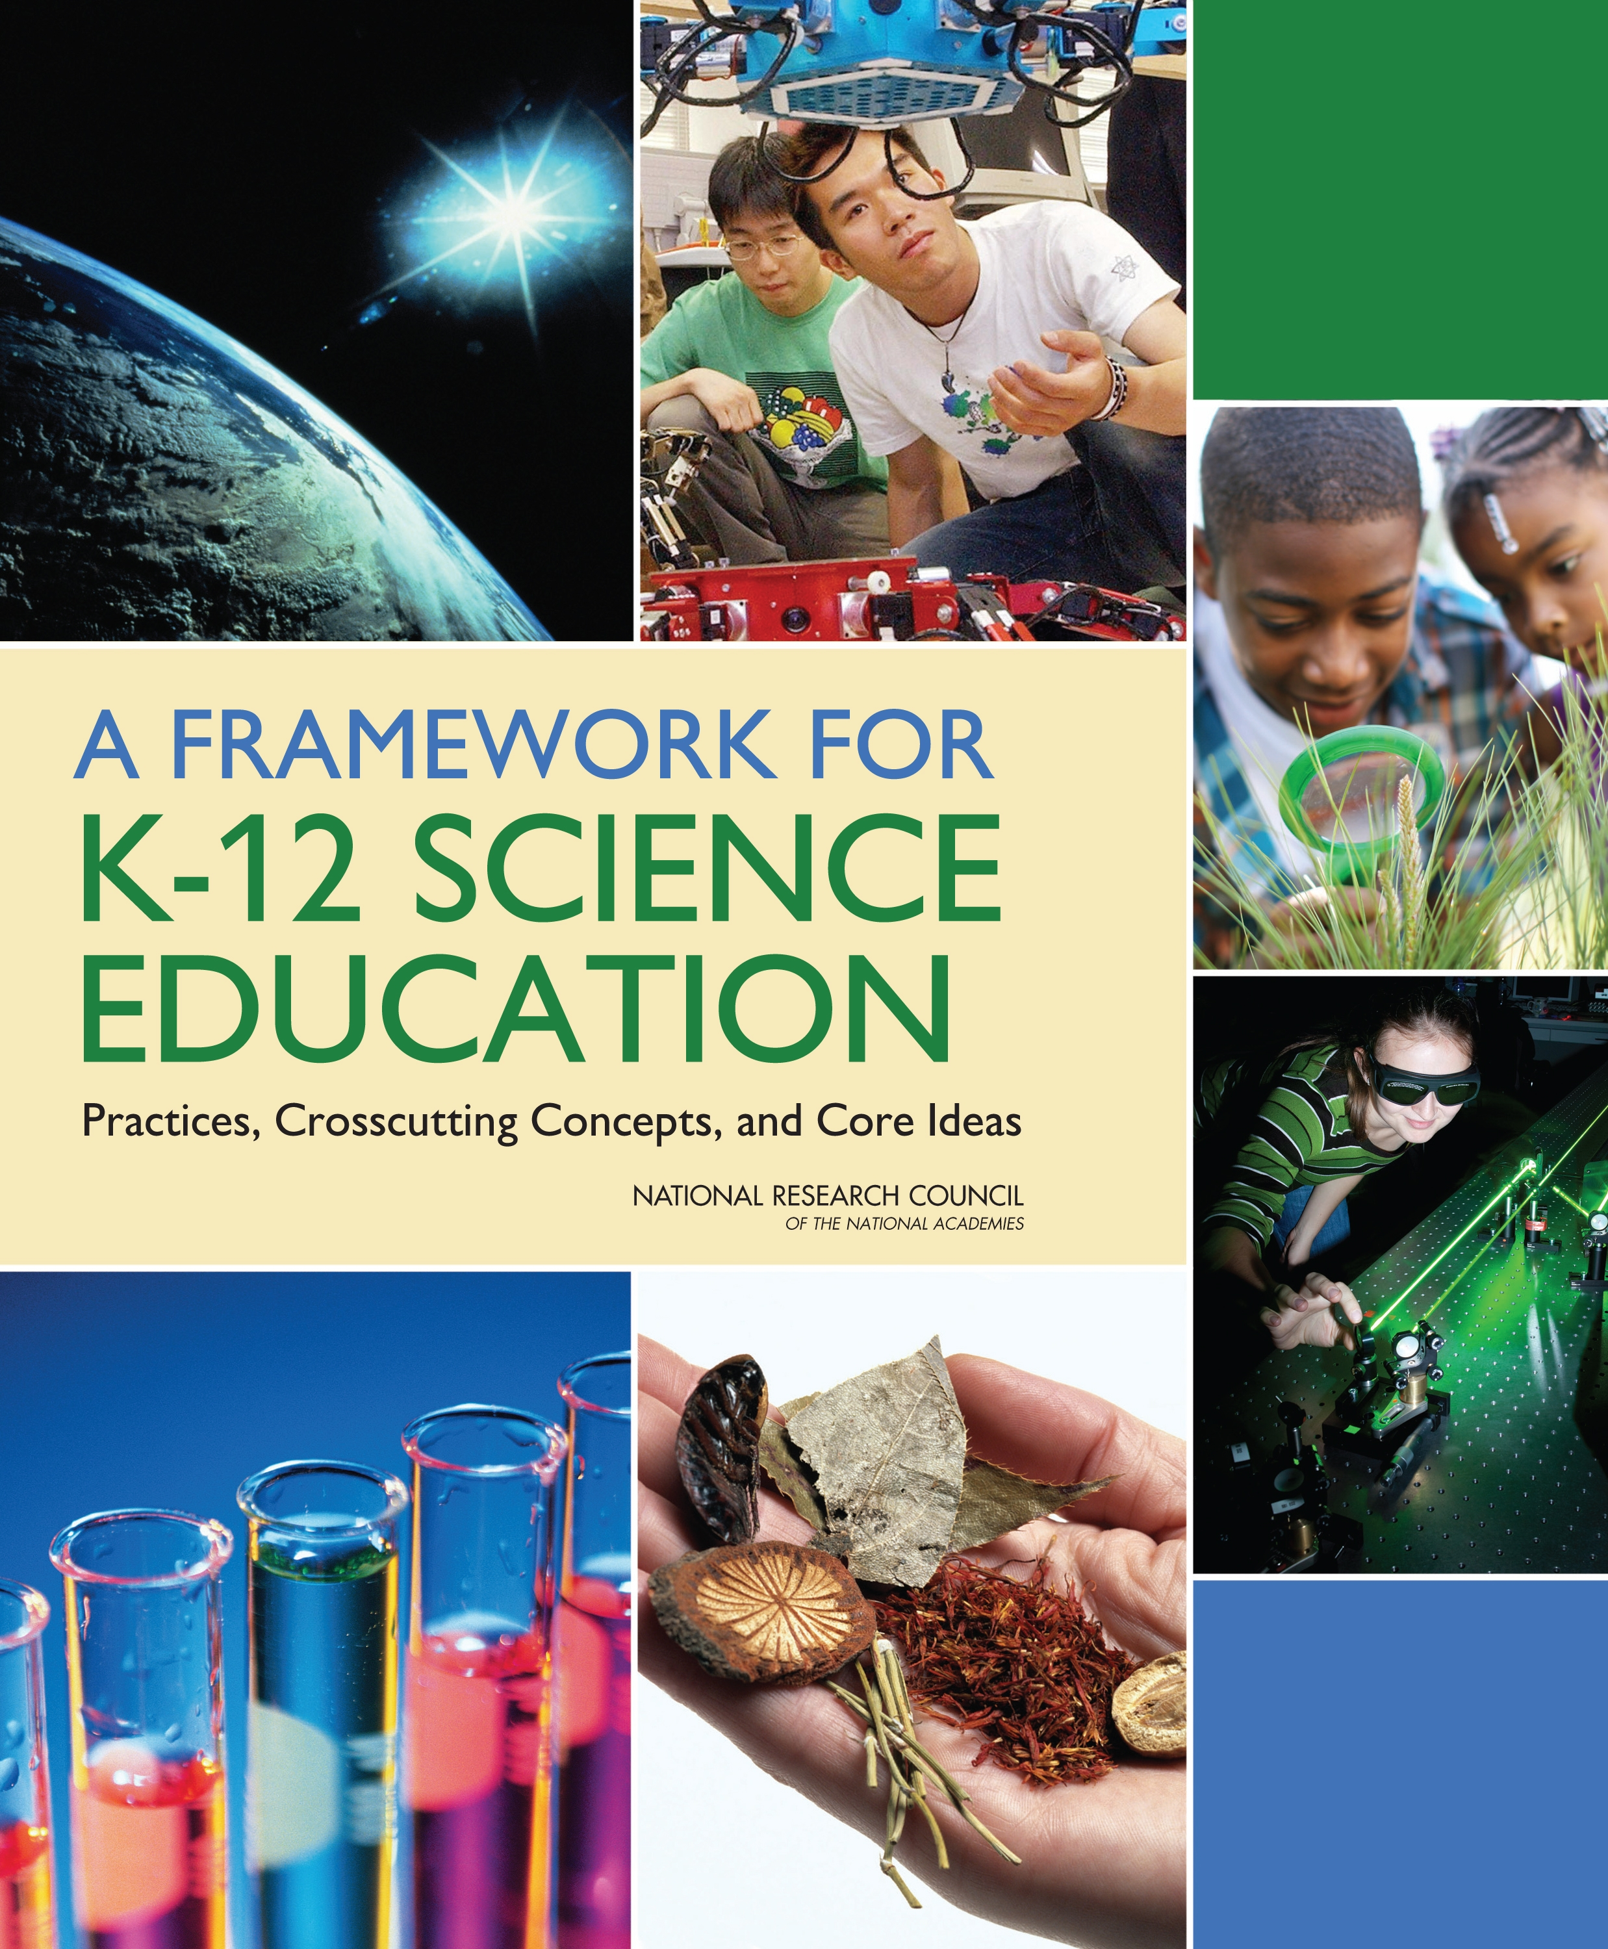
The NRC Framework for K-12 Science Education: Implications for Teacher Knowledge and Science Teaching
Brian J. Reiser
Northwestern University

Slide 2
Overview
What type of teaching engages learners in scientific practices, and constructing core explanatory ideas that develop over time?
What knowledge and practices do science teachers need to develop?

Slide 3
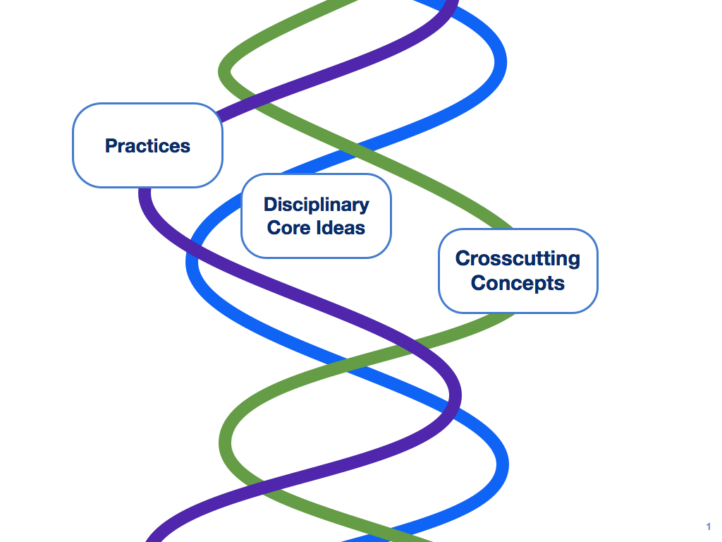
Overview of the framework
How is teaching changing?
Central role of scientific practices
Emphasis on coherence: building and applying ideas across time
Notes:
CONNECTION BOXES! Connections between ideas are marked in the NGSS
Backward and forward conns btwn grades
Conns to ELA and math common core

Slide 4
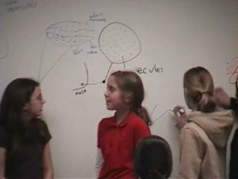
Key Role of Scientific Practices
Developing explanatory core ideas requires engaging in practices to build, synthesize, apply, and refine the ideas over time.
“Standards should include performance expectations that integrate the scientific and engineering practices with the crosscutting concepts and disciplinary core ideas. These expectations should require that students demonstrate knowledge-in-use and include criteria for identifying successful performance.” (NRC 2011, Rec 5).

Slide 5
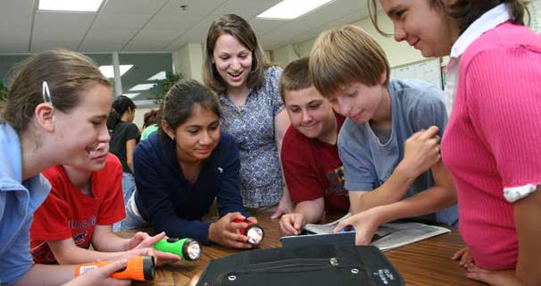
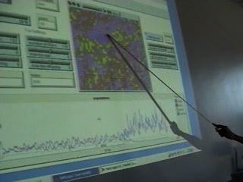
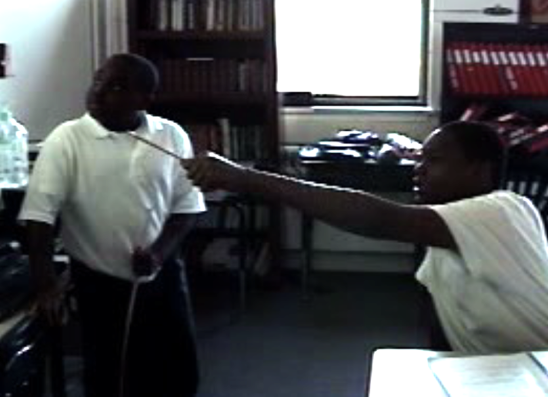
Scientific and Engineering Practices
1. Asking questions and defining problems
2. Developing and using models
3. Planning and carrying out investigations
4. Analyzing and interpreting data
5. Using mathematics and computational thinking
6. Developing explanations and designing solutions
7. Engaging in argument from evidence
8. Obtaining, evaluating, and communicating information
Notes:
5

Slide 6
Evolution from Inquiry to Scientific Practices
Focus not just on “investigation of hypotheses” but on building ideas -- making sense of findings, using results to develop models, argue competing explanations and reach consensus
Includes collaboration and discourse elements of working together to develop scientific knowledge
1. Asking questions and defining problems
2. Developing and using models
3. Planning and carrying out investigations
4. Analyzing and interpreting data
5. Using mathematics and computational thinking
6. Developing explanations and designing solutions
7. Engaging in argument from evidence
8. Obtaining, evaluating, and communicating information

Slide 7
Defining Scientific Practices
Develop, test, and refine scientific explanations, models, and theories
Cognitive work:
Steps to gather evidence, build explanation
Criteria to guide and evaluate (understanding of science)
Social interaction: How to interact with others to do the scientific work
Discourse: How to communicate about the science
Notes:
So we need to define SCIENTIFIC PRACTICE
What is involved? Goal. + THREE APSECTS

Slide 8
Example of teaching with practices: What does the invader eat?
Foxes
⬆
Invader
Rabbits
⬆?
⬆
Grass
Notes:
One week activity
The students were given this food web, with foxes, rabbits and grass. What happens when an unknown organism — the invasive species — comes into the ecosystem?
[leema’s notes
Students worked with this simulation to explain population fluctuations displayed on graphs like this. After becoming familiar w/ the food chain, students introduced an unknown organism -- the IS -- into the ecosystem and examined the population fluctuations in order to determine the role this organism played in the ecosystem -- how did it affect the other organisms?
To give you an iea of the data they were grappling w/ let me draw your attention to the graph behind me….in this graph, the rabbit population died out and the grass population stayed pretty consistent when the invader came in. This caused a lot of cnfusion b/c the simplest explanation for this is that the invader ate the rabbits -- killing them. But, this does not explain how the IS could survive w/o the rabbits, nor does it explain why the grass population didn’t sky rocket once there were no more rabbits eating it.
These problems are solved when one thinks of competition -- the rabbits died out not because of a predator/prey relationship but b/c the invader was eating their food

Slide 9
Aspects of argumentation
Students defending ideas with evidence from graphs
Students substantively critiquing each other’s explanations for the data
Investigations can be structured to encourage students to compare ideas and question each other
Reaching consensus is the most challenging aspect for teachers to support.
Notes:
Tyler — pointing to graph to defend “doesn’t eat grass”.
Issac pointing out problem with Tyler’s claim that eats rabbits. The invader survived after rabbits were at 0, so it can’t only eat only rabbits.
Structured by curric and T’s implementation
4. Reaching agreement was difficult. (You ain’t got nothing!!) Tyler did agree it must eat something else, in addition to rabbits. But not the grass as Issac was arguing earlier.
In this classroom it seems like the competitive nature of their questioning of one another may have gotten in the way.

Slide 10
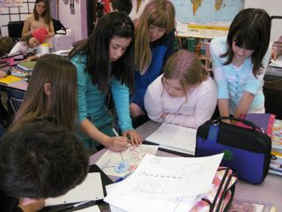
Developing and using scientific models
A scientific model
An abstract, simplified representation of a system
Models generate explanations and predictions of scientific phenomena.
Elements of the practice
Constructing models from evidence
Using models to explain phenomena
Evaluate models against evidence
Revise models to improve explanations
Notes:
Second example focuses on representing ideas as scientific models
Following the literature…

Slide 11
Example of teaching with practices: Modeling in Middle School
6th grade unit on particle model of matter.
Early lesson — students’ intuitive models for how odors travel through air.
Teacher asked students to compare their models: “I picked you because you all had different models.”

Slide 12
“First, I disagree with myself and my model”
Teaching support for the norms that guide practices
We need to compare our ideas to see where we agree or disagree
We are going to disagree at first
It is OK to change your answers to improve them
The goal is to reach consensus
Notes:
First I disagree with myself and my model. —- This is the kind of thinking we are hoping to support. Evaluating their models, deciding how to improve them.
Look at what curric and teacher did to support this.
SUMMARY— SUPPORT FOR PRAACTICE HAS TO GO BEYOND “WHAT TO DO.” CREATE SITUATION WHERE STUDENTS CAN BUY INTO THE NEED TO DO IT, SEE WHY IT MAKES SENSE, AND ALSO PROVIDE GUIDANCE ABOUT HOW TO DO IT.

Slide 13
Using Models as Tools to Explain
Students use models to explain
…represent and revise their understandings as they proceed through the investigations.
…articulate the mechanisms underlying phenomena (moving beyond descriptions)
…evaluate the model’s consistency with phenomena
…make predictions from the model

Slide 14
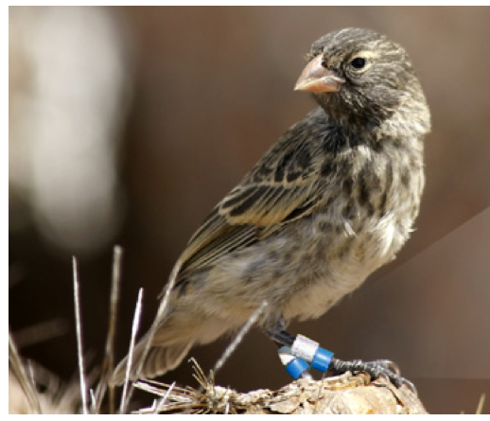
Example: Developing explanations by investigating primary data
Scientists in the Galapagos were surprised to see a large drop in the population of finches during several years of their study. From 1976 through 1977, a large majority of finches died, while others survived.
Why are so many finches dying?
Why are some of the finches able to survive?

Slide 15
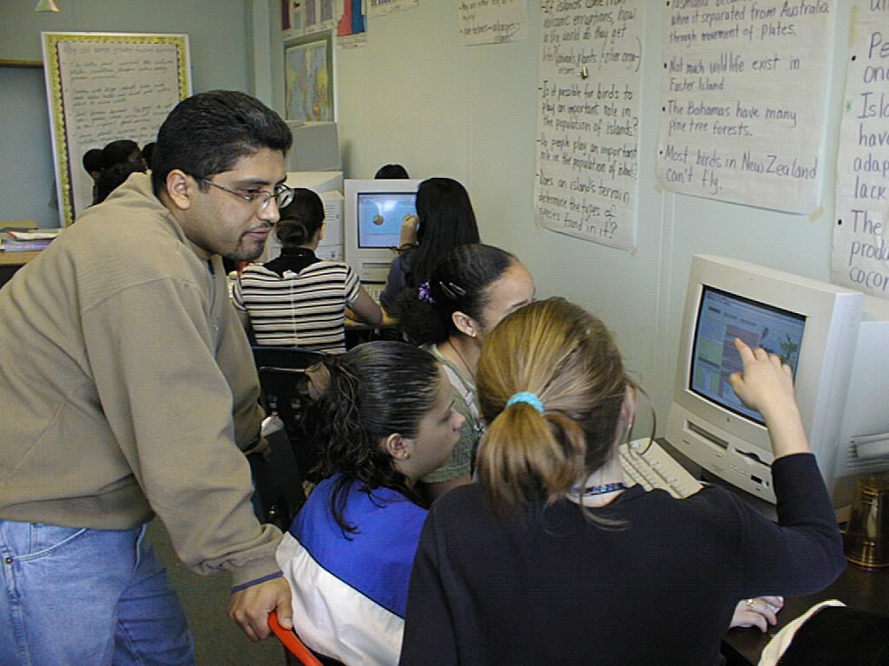
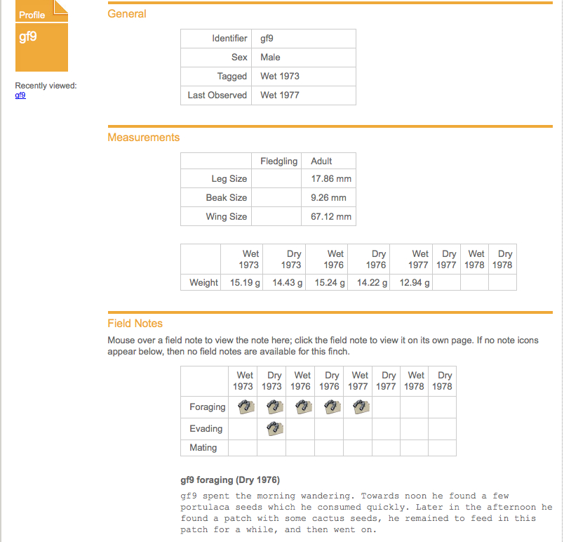
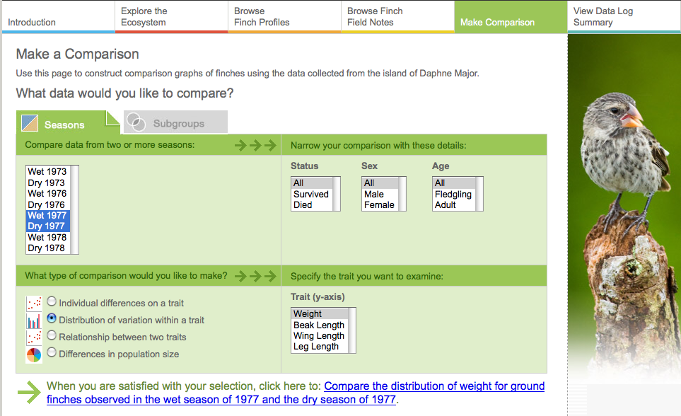
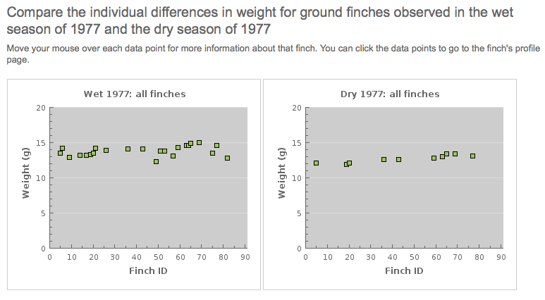
Developing explanations by investigating primary data

Slide 16
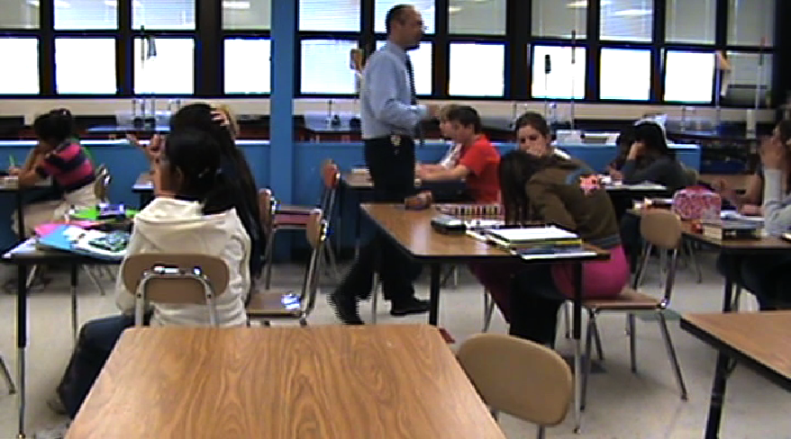
Developing Explanations and Engaging in Argument from Evidence
What have you all found out from the data so far?
Notes:
AT MIDPOINT. HAVE LOOKED AT LOTS OF DATA. STARTED TO FORM CONCLUSIONS. NOT YET ASSEMBLED ALL THEIR IDEAS INTO ARGUMENTS YET.

Slide 17
Argumentation as part of developing explanations
Supporting claims with evidence
Developing chains of cause and effect with multiple steps
Comparing alternative possible explanations
Using other students’ critiques to clarify explanations (with teacher help).

Slide 18
Causal Explanation for population change
The finches with longer beaks had a better chance at survival than those with shorter beak lengths.
All of the dry seasons had very little rain. However, all of the wet seasons have between 150 and 200 cm of rain except the wet season of 1977. This proves that there was a drought.
There were the fewest number of seeds in the wet and dry seasons of 1977. The wet season of 1977 had the fewest number of seeds than any other wet season.
There were the fewest number of finches in the dry season of 1977. This was because of the shortage of food in 1977.
The beak lengths for the finches that died in the wet season of 1977 ranged from 9.0 to 12.9. The beak lengths for the finches that survived in the wet season of 1977 ranged from 10.5 to 13.9. This shows that the finches that survived during the drought had longer beaks than those who died in the drought.
.
Main claim
Drought
Seeds
Claim
Differential survival

Slide 19
There was a drought in the wet and dry seasons of 1977. Both seasons in 1977 had a shortage of rain. Since there was less rain, there were fewer plants that were growing. Since there were fewer plants, there were fewer seeds and less food for the finches. Since there was less food, the finches had to dig down into the ground to find the food. Therefore, the longer their beaks were, the better chance they had of finding food in the ground. There were more deaths in the wet season of 1977. The finches with the longer beaks could crack open the few seeds left on the island.
Chain of cause and effect

Slide 20
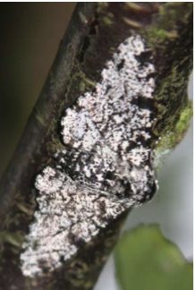
Developing General Models from Explanations of Cases
Natural Selection Model
Variation that can be inherited
Change in environment
Advantage: Some survive due to the variation on the trait
Survivors have offspring
Next generation has increased numbers with the advantaged trait.
Differences increase over generations.
Finches Explanation
Peppered
Moths Explanation

Slide 21
Teaching with scientific practices
Teachers need to help make the scientific investigation meaningful, not rote steps
Create a need for the investigation through rich questions applied to phenomena
Teachers need to support multiple aspects of doing the work
Scaffolding for performing the scientific work.
Support social interactions that help get the work done.
Support discourse in communicating to get the work done.
Notes:
What does it mean to be meaningful for students? To make the practice meaningful
Need — STUDENTS SEE UTILITY OF THE PRACTICE

Slide 22
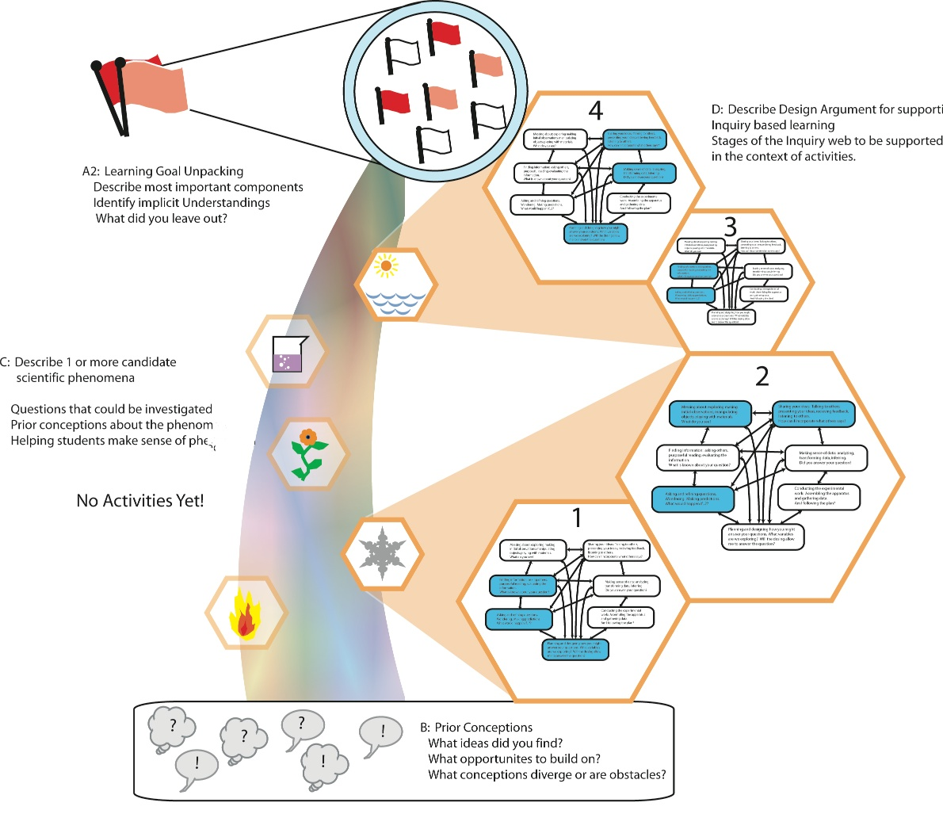
Preparing teachers to focus on coherence
Learning goal Unpacking
Storyline of investigation
Candidate phenomena to investigate and explain
Prior conceptions analysis

Slide 23
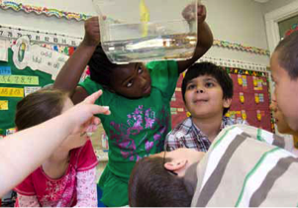
Taking practices, cross cutting concepts, and core disciplinary ideas into the classroom
Changes needed in teacher preparation and development:
Focus on disciplinary core ideas as learning goals
Engage teachers in scientific practices
Encourage teachers to adapt current curriculum materials to embed explanation, argumentation and modeling
Engage cooperating teachers with investigations of the Framework

Slide 24
