Slide 1
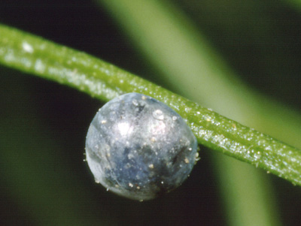
Organization of Meeting and Expectations for State Teams
Facilitated by Brett Moulding
8:45 – 9:15 AM

Slide 2
Nature of the Meeting
The sessions are designed to support state teams building capacity for valuing and using the Framework and NGSS Standards.
This is the second in a series of meetings.
Developing and/or enhancing state science education plans.
Networking, discussion, and planning at many levels to develop a shared vision for science education.
Developing, planning, and sharing resources and tools to support implementation of the Framework’s vision for science education.

Slide 3
Sharing Perspectives
Networking with others developing state science education initiatives and/or working with those engaged in existing state science education efforts similar to those in your state.
Role in system
State demographics, geography, other
Science education initiatives
Configuration of standards (e.g., grade-band, grade-level, performance statements, assessment type)
Timeline for standards’ adoption and implementation
Other
Networking and follow-up are expectations of this meeting.
Planning efforts to move from current condition of science education to those desired for the future.
Notes:
“Some people see things that are and ask, Why? Some people dream of things that never were and ask, Why not? Some people have to go to work and don't have time for all that.” ― George Carlin

Slide 4
Day One
Framework to Standards – Vision
Breakouts – Inspirations, Insights, Information, Work
State Team Discussions (see handout)
Nourishment (Lunch) and Networking
Assessing NGSS Standards – Vision
Breakouts – Inspirations, Insights, Information, Work
Reality, Practical Applications, and Communication
Synthesis
Networking
Inspiration and Nourishment

Slide 5
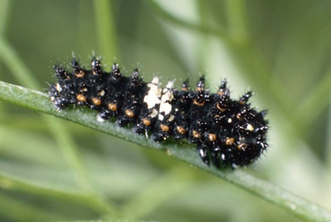
Day Two
Partnerships – Strategies
Developing Plans – Work
Breakouts –Inspirations, Insights, Information, Work
Sharing Draft Plans – Networking
Nourishment (Lunch) and Networking
Synthesis, Sharing, and Reflection
Next Steps
Notes:
Investigating CCSS Mathematical and Literacy Practices with Framework Science and Engineering Practices - Sarah Michaels
Implementing the Vision – Framework, Role of Instructional Resources - Brian Reiser
Thinking More about Science & Engineering Practices - Jonathan Osborne
Understanding and Forming Research & Practice Partnerships: Q & A and Networking Opportunities – Bill Penuel
Developing State Plans , Facilitator- Brett Moulding
Messaging Strategies In and Across States – Bringing Together Communications & PR Specialists, Policy Makers and Agency Staff, Corporate Community - Jean Moon
Discussing Formative and High Stakes Assessment in Science Education, What to Expect - Rodger Bybee

Slide 6
Day Two – State Planning
Saturday
9:30 – 10:30 AM General Session Work at Tables
State Teams Work to Develop Plans for Sharing Science Education Vision
10:45 – 11:45 AM Breakout Session III
Developing State Plans
11:45 – 12:15 PM Poster Session
State Teams Visiting Other States’ Plans – Travel from Table to Table
1:00 – 2:00 PM General Discussion
Putting it all together – What are the essential components of your state plan and what are the specific actions to implement a new vision for science education?

Slide 7
Breakout Session I
Investigating CCSS Mathematical and Literacy Practices with Framework Science and Engineering Practices
Continuing Knowledge Building on the Structure and Vision of the Framework along with Crosscutting Concepts & Disciplinary Core Ideas
Implementing the Vision – Teacher Knowledge in Pre-service and Professional Development Settings
Working on BCSSE Framework Tools
Understanding & Forming Research & Practice Partnerships as a Critical Strategy to Advance Science Education
Building Fluency in Science & Engineering Practices
Promoting Diversity & Equity in Science Education Using the Framework
Notes:
Red -

Slide 8
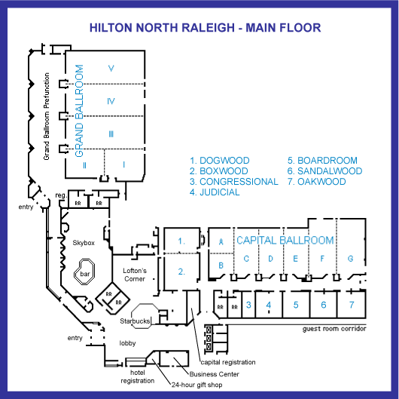
Notes:
Congressional - Deadwood joke could go here.

Slide 9
Structure of the Meeting
General Session
Breakout Sessions to Develop Understanding of Framework
State Discussion and Planning
Vision of Science Education
Discussion Across States and Networking on Improving Science Education
Breakout Sessions to Support Implementing a New Vision for Science Education
States Plan for Implementing the Vision for Science Education
Follow-up to General Sessions to Develop Greater Understanding of Science Education

Slide 10
Goals for Science Education
The Framework’s vision takes into account two major goals for K-12 science education:
Educating all students in science and engineering.
Providing the foundational knowledge for those who will become the scientists, engineers, technologists, and technicians of the future.
The Framework principally concerns itself with the first task--what all students should know in preparation for their individual lives and for their roles as citizens in this technology-rich and scientifically complex world.
Framework 1-2
Notes:
It is important for us to keep in mind the goals for science education. The Framework states these goals.

Slide 11
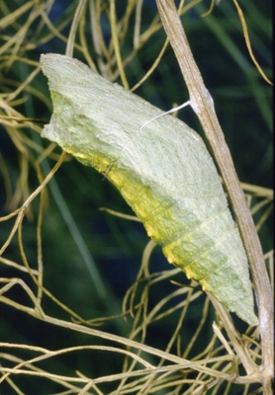
Planning for Future Meetings
Many topics are in play at this meeting, but not all important topics will be fully addressed.
Important topics and ideas that need to be addressed in future BCSSE and CSSS meetings should be captured in some fashion.
Meeting evaluation form
Recorders’ notes from discussions
Video Taping
Other

Slide 12
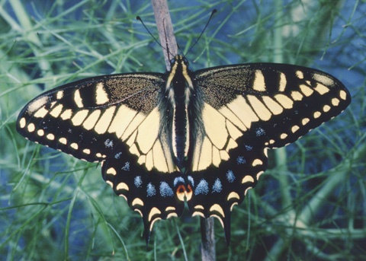
The Forks in the Road
“You see things; and you say, 'Why?' But I dream things that never were; and I say, 'Why not?'”
George Bernard Shaw
“Some men see things as they are and say "why?” I dream things that never were and say "why not?” Robert F. Kennedy
“Some people see things that are and ask, Why? Some people dream of things that never were and ask, Why not? Some people have to go to work and don't have time for all that.” George Carlin
Notes:
There are those that look at things the way they are, and ask why? I dream of things that never were, and ask why not?
Though Kennedy stated that he was quoting George Bernard Shaw when he said this, he is often thought to have originated the expression, which actually paraphrases a line delivered by the Serpent in Shaw's play Back To Methuselah : “You see things; and you say, ‘Why?’ But I dream things that never were; and I say, ‘Why not?’". Robert's brother Edward famously quoted it (paraphrasing it even further), to conclude his eulogy to his late brother after his assassination (8 June 1968): Some men see things as they are and say why? I dream things that never were and say why not? -

Slide 13
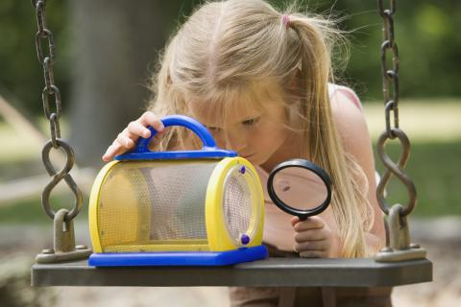
Notes:
We hope that you will enjoy the sessions and the opportunities for networking that you will have here at the BCSSE meeting in Raleigh.

