Slide 1
Research in Science Education
Richard A. Duschl
NSF-EHR & Penn State University
BCSSE Denver June 19-20 2014

Slide 2
What do we need to: Better understand? Explore? Learn/know how to do?
1) Think - Take 3 Post-it Notes and jot down three answers to the above question.
2) Pair – Discuss with ½ of tablemates and place the Notes into common UNIQUE categories. Write a new Post-it Note to label the categories.
3) Share – with All Table Members and coordinate all UNIQUE ideas/categories – display on wall or on table.
4) Think about how and who will get the research done. Voices? Methods? Audiences?

Slide 3
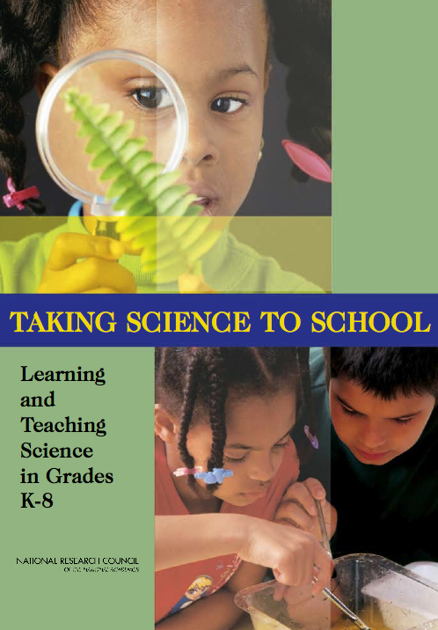
Taking Science to School (TSTS) National Research Council 2007

Slide 4
4 Strands of Scientific Proficiency
Know, use and interpret scientific explanations of the natural world.
Generate and evaluate scientific evidence and explanations.
Understand the nature and development of scientific knowledge.
Participate productively in scientific practices and discourse.

Slide 5
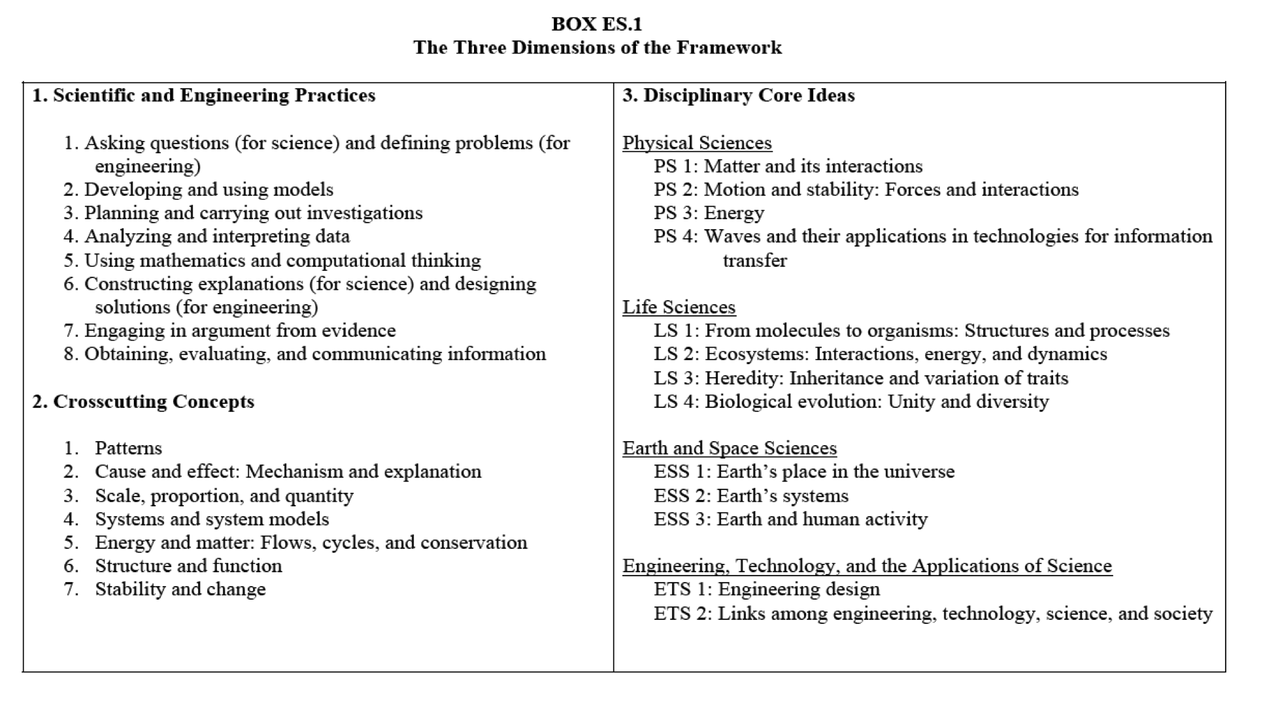

Slide 6
1-Learning Across the 4 Strands
Recommendations
4 Strands of Sci. Proficiency
Know, use and interpret scientific explanations of the natural world.
Generate and evaluate scientific evidence and explanations.
Understand the nature and development of scientific knowledge.
Participate productively in scientific practices and discourse.
Critical Research
Current focus on domain-general, domain-specific for 1 & 2; need research on Strands 3 & 4.
Learning & Mediation
Instructional Contexts
More research on interconnections of all 4 strands to inform instructional models

Slide 7
2-Core Ideas & Learning Progressions
Recommendations
Findings from research about children’s learning and development can be used to map learning progressions (LPs) in science.
Core ideas should be central to a discipline of science, accessible to students in kindergarten, and have potential for sustained exploration across K-8.
Teaching Science Practices during investigations
Argumentation and explanation
Model building
Debate and decision making
Critical Research
Requires an extensive R&D effort before LPs are well established and tested.
Step 1 - Id the most generative and powerful core ideas for students’ science learning
Step 2 - Develop and test LPs
Step 3 Establish empirical basis for LPs:
Focused studies under controlled conditions
Small-scale instructional interventions
Classroom-based studies in a variety of contexts
Longitudinal studies

Slide 8
3-Curriculum & Instruction
Recommendations
The strands emphasize the idea of “knowledge in use” – that is students’ knowledge is not static and proficiency involves deploying knowledge and skills across all four strands.
Students are more likely to advance in their understanding of science when classrooms provide learning opportunities that attend to all four strands
Science is a social phenomena with unique norms for participation in a community of peers.
Critical Research
Understand whether and how instruction should change with students’ development
Develop clear depictions of scientific practices across K-8 through replication of classroom-based instruction (e.g., design studies).
Develop assessment tools to help teachers diagnose students’ understanding
Understand characteristics of instruction that best serve diverse student populations
Develop curriculum materials studied under varied conditions

Slide 9
Learning & Learners
Conclusion 1:
The norms of scientific argument, explanation, and the evaluation of evidence differ from those in everyday life. Students need support to learn appropriate norms and language for productive participation in the discourses of science.
Conclusion 3:
What children are capable of at a particular age is the result of a complex interplay among maturation, experience, and instruction. Thus, what is developmentally appropriate is not a simple function of age or grade. What children can do is in large part contingent on their prior opportunities to learn and not on some fixed sequence of developmental stages.

Slide 10
Learning & Learners
Conclusion 4:
Students’ knowledge and experience play a critical role in their science learning, influencing all four strands of science understanding. Children’s concepts can be both resources and barriers to emerging understanding. These concepts can be enriched and transformed by appropriate classroom experiences. Science learners require instructional support to engage in scientific practices and to interpret experience and experiments in terms of scientific ideas.
Conclusion 6:
Race/ethnicity, language, culture, gender, and socioeconomic status are among the factors that influence the knowledge and experience children bring to the classroom. This diversity offers richness and opportunities in the classroom, and it also affects the kinds of support children need to learn science.

Slide 11
Curriculum & Instruction
Conclusion 8:
Sustained exploration of a focused set of core ideas in a discipline is a promising direction for organizing science instruction and curricula across grades K-8. A research and development program is needed to identify and elaborate the progressions of learning and instruction that can support students’ understanding of these core ideas. The difficult issue is deciding what to emphasize and what to eliminate.
Conclusion 9:
Students learn science by actively engaging in the practices of science. A classroom environment that provides opportunities for students to participate in scientific practices includes scientific tasks embedded in social interaction using the discourse of science and work with scientific representations and tools. Each of these aspects requires support for student learning of scientific practices.

Slide 12
Curriculum & Instruction
Conclusion 10:
Frequently, classroom investigations treat data collection and analysis as the end game of science. Instead, science is, and should be presented as, a process of building theories and models, checking them for internal consistency and coherence, and testing them empirically. Method should follow from theory, therefore presentation of scientific methodology should consider a broad range of methods, including acquiring and interpreting observational data and modeling . . . which should be reflected in the experiences provided in K-8 classrooms.
Conclusion 12:
Ongoing assessment is an integral part of instruction that can foster student learning when appropriately designed and used regularly. Assessments, whether formative or summative, need to be responsive to the full range of proficiencies that are implied by the strands. Assessment needs to be aligned with the research on students’ thinking as well as informed by the structure of the subject matter.

Slide 13
Teachers & Schools
Conclusion 13:
To create a successful science classroom, teachers need to modify and adapt curriculum materials so as to design instruction that is appropriate for a particular group of students at a particular time. Making these kinds of modifications to achieve effective instruction requires knowledge of science, knowledge of how students learn science, and knowledge of how to plan effective instruction. Many K-8 teachers have insufficient knowledge in one or all of these areas and need ongoing support to develop it.
Conclusion 14:
Achieving science proficiency for all students will require a coherent system that aligns standards, curriculum, instruction, assessment, teacher preparation, and professional development for teachers across the K-8 years.

Slide 14
Critical Research Question
How to organize programs of research so that they explicitly address problems of educational practice in schools while advancing fundamental understanding of children’s learning in science? Two key elements of such a program that need to be thought through are:
(1) What is the nature of the teams of individuals who should be brought together to conduct this work? and
(2) How can some common intellectual ground be developed so that dialogue can begin across the varied research traditions?

Slide 15
Shifting the Focus
From
Lessons, Modules Days Weeks
Management of Behaviors & Materials
Skills for doing experiments
Assessment of Learning
To
Sequences, Units Weeks Months Years
Management of Ideas & Information
Reasoning about experiments
Assessment for Learning

Slide 16
Critical Areas for Research and Development
Learning Across the Four Strands
Identifying Core Ideas and Developing Learning Progressions
Curriculum and Instruction
Professional Development and Teacher Learning
Evaluation and Scale-Up
Diversity and Equity

Slide 17
Ten Years After
Advances in basic research on the biological, the neurological, and the cognitive bases of learning.
Advances in applied research on the positive influence engagement in participatory practices has on learning.
Developments in technology that can enable the study of brain functions, learning and instructional delivery systems, and the assessment of learning.
Advances in evidence-centered design methodologies for the comprehensive measurement of learning.

Slide 18
Richer understandings of processes and mechanisms that stimulate motivation, persistence and identity.
Characterizations of conceptual and epistemic reasoning and of knowledge building processes from analyses of professional practices.
Emergence of design-based implementation methodologies to study institutional learning systems as well as formal and informal learning ecologies.

