Slide 1
What’s Common Across ELA, Math, and Science?
The Challenge of “Making Thinking Visible” in the Service of Evidence-Based Argument
Sarah Michaels (Clark University) & Cathy O’Connor (Boston University)
Building Capacity for State Science Education (BCSSE)
February 24-25, 2012
Notes:
The title of my talk is “What’s Common Across ELA, Math, and Science? The Challenge of “Making Thinking Visible” – AVAILABLE -- in the Service of Evidence-Based Argument, co-authored with Cathy O’Connor who can’t be here today. I’m going to be focusing particular attention on the identified “practices” as outlined in the Common Core standards in math and ELA and the Framework for K-12 Science Education, and I’ll use the term “the new standards” as a short hand.

Slide 2
States are faced with implementing the CCSS in math and ELA.

Slide 3
Are the Next Generation Science Standards just “one more thing” for the states to implement? Will they take a back seat to the “real” core?
Notes:
And the real question in everyone’s minds is: Are the Next Generation Science Standards just “one more thing” for the states to implement? Will they take a back seat to the “real” core? Just as has happened in the NCLB era, will science be the afterthought, in PD efforts and instructional time, an add-on in elementary school, when we have time? Will the science exemplar texts embedded in the ELA standards become the vehicle for teaching science?

Slide 4
I’m going to argue that the
Next Generation Science Standards can be a centerpiece that exemplifies what has to happen with ALL core areas.
Notes:
I’m going to argue that the Next Generation Science Standards can actually be a centerpiece that exemplifies what has to happen with ALL core areas.

Slide 5
It turns out that there are commonalities at the core of these standards –
in ELA, math, and science.

Slide 6
ALL the standards — math, ELA and science — require that teachers focus more attention on reasoning and “thinking practices.”
Notes:
ALL the standards — math, ELA and science — require teachers to focus much more attention on reasoning and thinking practices.

Slide 7
These high level “thinking practices” require that students participate in making their thinking public and cogent.
Notes:
These high level “thinking practices” require that students participate in making their thinking public and cogent.

Slide 8
•visible,
•public,
•available to others, in talk and in writing.
Students will have to participate, with guidance, in making their thinking

Slide 9
This is not trivial.

Slide 10
Teachers will have to help all students:
Externalize their thinking;
Listen carefully to one another
and take one another seriously;
Dig deeper into the data and evidence for their positions;
Work with the reasoning of others.
Notes:
For this to happen teachers are going to have to find ways to help all students (including English Language Learners, Language Minority Students, struggling students, all students)
go public with their ideas, CLICK externalize their thinking so that others can build on it; t…
they’re going to have build a classroom culture where students think with each other, construct arguments, critique the thinking of their peers, and make progress collectively on important problems.

Slide 11
I’m going to argue that science is best situated to do this.
Science educators can take a leadership role in showing educators across the content areas how this can be done.
Notes:
Ultimately, I’m going to argue that…

Slide 12
Plan for the next 55 minutes
What’s common in math, ELA and science? And why will an emphasis on discussion become so critical?
What does this look like in practice?
What’s the evidence that this will work?
What is needed and what’s already available?
Notes:
What’s common in the math, ELA, and science framework And why an emphasis on discussion and well-structured, guided, discourse-intensive pedagogy will become so ciritical.
What does this look like in practice? -- Here we’ll look together at some videos.
What’s the research evidence that this can and will work?
What is needed if teachers are going to rise to the challenge that these new standards entail? Here I’m going to talk both about the challenges we face, and some of the newest developments and resources that are already available.

Slide 13
There’s a common core in all of the standards documents
(ELA, Math, and Science)
At the core is:
Reasoning with evidence.
Building arguments and critiquing the arguments of others.
Developing rigorous, conceptually strong, evidence-based thinking practices.
Participating in reasoning-oriented practices, with others.
Notes:
So let me go back to what’s common -- at the core -- of all of the standards documents -- a closer look at what I’ve hinted at.

Slide 14
An Examination of “Practices”
Science and Engineering Practices
  1. Asking questions and defining problems
  2. Developing and using models
  3. Planning and carrying out investigations
  4. Analyzing and interpreting data
  5. Using mathematics, information and computer technology, and computational thinking
  6. Constructing explanations and designing solutions
  7. Engaging in argument from evidence
  8. Obtaining, evaluating, and communicating information

Slide 15
An Examination of “Practices”
Mathematical Practices
  1. Make sense of problems and persevere in solving them.
  2. Reason abstractly and quantitatively.
  3. Construct viable arguments and critique the reasoning of others.
  4. Model with mathematics.
  5. Use appropriate tools strategically.
  6. Attend to precision.
  7. Look for and make use of structure.
  8. Look for and express regularity in repeated reasoning.

Slide 16
Let’s look in detail at shared elements in the Standards documents
Math Practice #3:
  Construct viable arguments and critique the reasoning of others
Science and Engineering Practice #7:
  Engaging in argument from evidence

Slide 17
Argumentation
Construction
Critique
Creating Common Ground
Notes:
In science we often talk about the fundamental practices of “construction” (developing claims with evidence) and critique. I think we want to add one more fundamental practice -- developing collective “consensus” on common ground -- so that we are generating, as a community, useable knowledge that we can build upon.

Slide 18
A few more of these practices seem to relate explicitly to sense-making and discussion: reasoning, in the service of arguments.

Slide 19
Where do we see “sense-making” in the math CCSS?
Mathematical Practices
  1. Make sense of problems and persevere in solving them.
  2. Reason abstractly and quantitatively.
  3. Construct viable arguments and critique the reasoning of others.
  4. Model with mathematics.
  5. Use appropriate tools strategically.
  6. Attend to precision.
  7. Look for and make use of structure.
  8. Look for and express regularity in repeated reasoning.

Slide 20
Where do we see “sense-making” in the science Framework practices?
Science and Engineering Practices
  1. Asking questions and defining problems
  2. Developing and using models
  3. Planning and carrying out investigations
  4. Analyzing and interpreting data
  5. Using mathematics, information and computer technology, and computational thinking
  6. Constructing explanations and designing solutions
  7. Engaging in argument from evidence
  8. Obtaining, evaluating, and communicating information

Slide 21
But what about ELA? Are the same reasoning practices common here as well?
The ELA standards emphasize “processes” of communication –
•reasoning
•critiquing arguments with evidence
•communicating with others

Slide 22
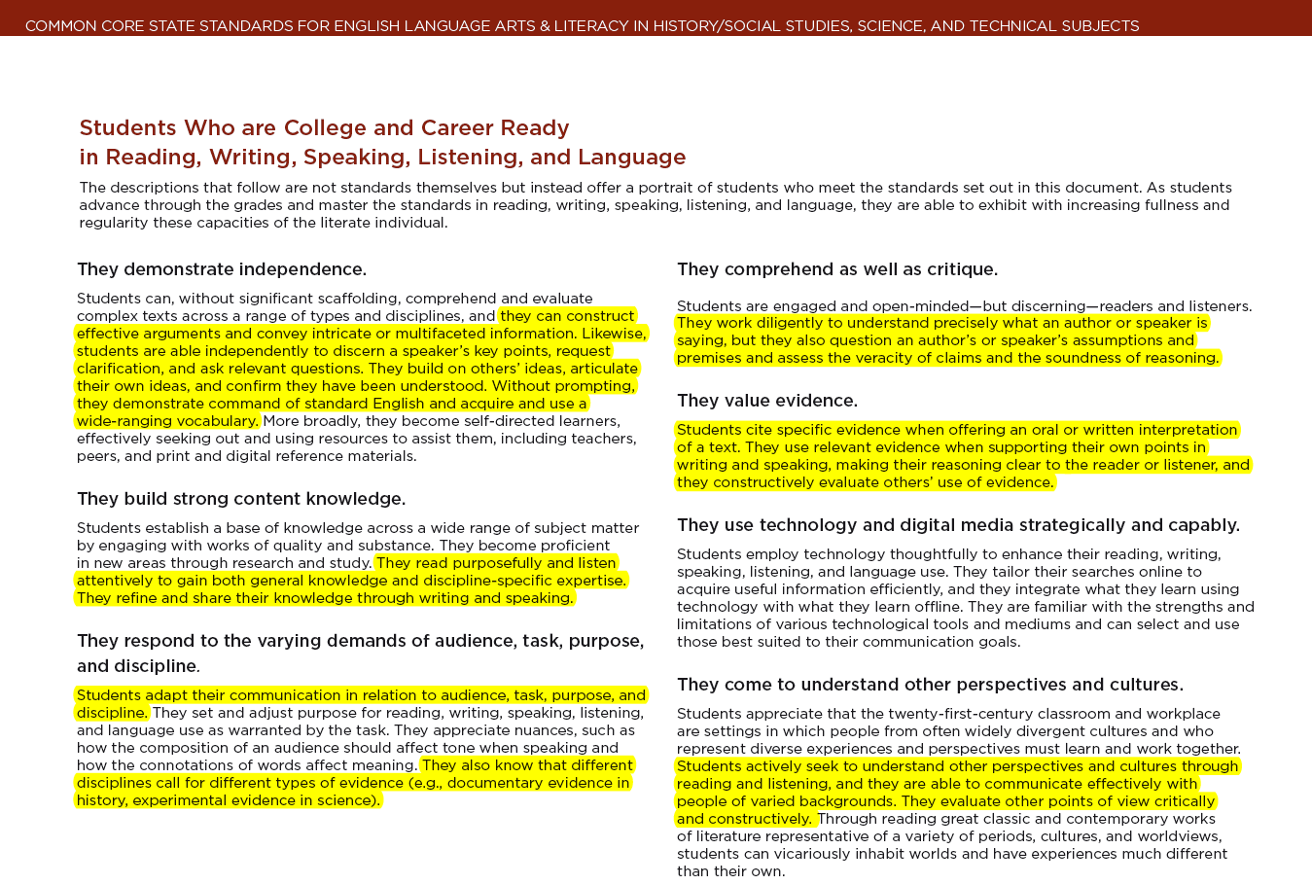
Instead of “practices,” the ELA Standards identify the “capacities” of the literate individual:
Notes:
Instead of “practices,” the ELA Standards identify the –CLICK-- “capacities” of the literate individual: The literate individual builds strong content knowledge. The literate individual comprehends as well as critiques. The iterate individual values evidence.

Slide 23
In the fine print:
… “construct effective arguments,” “request clarification,” “ask relevant questions,” “build on others’ ideas,” “articulate their own ideas,” “question assumptions and premises,” “assess the veracity of claims,” “assess the soundness of reasoning,” “cite specific evidence,” “make their reasoning clear,” “constructively evaluate others’ use of evidence,” “evaluate other points of view critically and constructively,” “express and listen carefully to ideas,” “cite specific textual evidence to support conclusions,” “delineate and evaluate the argument and specific claims in a text including the validity of the reasoning as well as the relevance and sufficiency of the evidence,” “participate effectively in a range of conversations and collaborations with diverse partners, building on others’ ideas and expressing their own clearly and persuasively.”
Notes:
The heart of the matter -- here in the ELA Standards, but almost word for word the same in the mathematics and science documents.

Slide 24
In the fine print:
… “construct effective arguments,” “request clarification,” “ask relevant questions,” “build on others’ ideas,” “articulate their own ideas,” “question assumptions and premises,” “assess the veracity of claims,” “assess the soundness of reasoning,” “cite specific evidence,” “make their reasoning clear,” “constructively evaluate others’ use of evidence,” “evaluate other points of view critically and constructively,” “express and listen carefully to ideas,” “cite specific textual evidence to support conclusions,” “delineate and evaluate the argument and specific claims in a text including the validity of the reasoning as well as the relevance and sufficiency of the evidence,” “participate effectively in a range of conversations and collaborations with diverse partners, building on others’ ideas and expressing their own clearly and persuasively.”
Notes:
The heart of the matter -- here in the ELA Standards, but almost word for word the same in the mathematics and science documents.

Slide 25
In the fine print:
… “construct effective arguments,” “request clarification,” “ask relevant questions,” “build on others’ ideas,” “articulate their own ideas,” “question assumptions and premises,” “assess the veracity of claims,” “assess the soundness of reasoning,” “cite specific evidence,” “make their reasoning clear,” “constructively evaluate others’ use of evidence,” “evaluate other points of view critically and constructively,” “express and listen carefully to ideas,” “cite specific textual evidence to support conclusions,” “delineate and evaluate the argument and specific claims in a text including the validity of the reasoning as well as the relevance and sufficiency of the evidence,” “participate effectively in a range of conversations and collaborations with diverse partners, building on others’ ideas and expressing their own clearly and persuasively.”
Notes:
The heart of the matter -- here in the ELA Standards, but almost word for word the same in the mathematics and science documents.

Slide 26
In the fine print:
… “construct effective arguments,” “request clarification,” “ask relevant questions,” “build on others’ ideas,” “articulate their own ideas,” “question assumptions and premises,” “assess the veracity of claims,” “assess the soundness of reasoning,” “cite specific evidence,” “make their reasoning clear,” “constructively evaluate others’ use of evidence,” “evaluate other points of view critically and constructively,” “express and listen carefully to ideas,” “cite specific textual evidence to support conclusions,” “delineate and evaluate the argument and specific claims in a text including the validity of the reasoning as well as the relevance and sufficiency of the evidence,” “participate effectively in a range of conversations and collaborations with diverse partners, building on others’ ideas and expressing their own clearly and persuasively.”
Notes:
The heart of the matter -- here in the ELA Standards, but almost word for word the same in the mathematics and science documents.

Slide 27
Making Thinking Visible
-to self and others - through language
(talk and text) is at the core, in science, math, and ELA.
Notes:
Making thinking visible (and available) to self and others --

Slide 28
But let’s take a deeper look at the identified “practices,” even the ones that don’t explicitly mention talk.

Slide 29
An Examination of “Practices”
Science and Engineering Practices
  1. Asking questions and defining problems
  2. Developing and using models
  3. Planning and carrying out investigations
  4. Analyzing and interpreting data
  5. Using mathematics, information and computer technology, and computational thinking
  6. Constructing explanations and designing solutions
  7. Engaging in argument from evidence
  8. Obtaining, evaluating, and communicating information

Slide 30
An Examination of “Practices”
Mathematical Practices
  1. Make sense of problems and persevere in solving them.
  2. Reason abstractly and quantitatively.
  3. Construct viable arguments and critique the reasoning of others.
  4. Model with mathematics.
  5. Use appropriate tools strategically.
  6. Attend to precision.
  7. Look for and make use of structure.
  8. Look for and express regularity in repeated reasoning.

Slide 31
In order to learn HOW to model, or analyze data, or use appropriate tools, students have to participate in these practices, with others, primarily through talk, joint attention, and shared activities.
Notes:
What counts as a workable model, does it account for the data? Is this one better than that one? Or even closer to home – based on a discussion I heard 5th graders having just last week – they were trying to determine if the salt they had added to their mini-lakes (and which seemed to disappear) was still there, by weighing their mini-lakes before and after. They got different results from group to group. And they had to figure out what the difference meant? Are the differences meaningful – Where they due to human error, due to limitations of our measuring tools (our digital scale were only precise to one gram – is that why we got different results), or were the difference real and therefore had to be explained?

Slide 32
Through talk, joint attention, and shared activities, students and teacher can create common ground.
To do this, they have to talk about what’s in the common ground.
Notes:
It’s through talk, joint attention, and shared activity that we create common ground, and in order to make collective progress in thinking, we have to be able to talk about what’s in that common ground.

Slide 33
“Reasoning practices” have to be enacted, and for learners, most are enacted socially, through talk and writing.
“SOCIAL” does not just mean
student-led group work.
Well-structured social interaction builds in time to think as an individual–
making thinking available.

Slide 34
Because these “thinking practices” are inextricably linked to content, and to core ideas, participating in productive talk is not an add-on.
It’s fundamental to the learning goals in each set of standards.

Slide 35
Students have to be inducted into these “thinking practices” socially.
They have to be guided to participate in them —
through well-structured discussion;
through “productive talk.”
Notes:
So here’s my overarching claim: At the core of the standards are thinking practices, and students have to be inducted into these “thinking practices” socially. They have to be guided to participate in them — through well-structured discussion… CLICK through Productive Talk.

Slide 36
Bottom Line:
Well-structured talk — discussion or guided, scaffolded reasoning talk — will have to become the new foundation for the common core.
Notes:
This is why new forms of talk -- discussion -- guided, scaffolded reasoning talk will have to become the new foundation for the common core.

Slide 37
What is “productive talk?”
What does it look like and sound like?
Notes:
But let’s stop for a moment, and ask ourselves: What does well-structured discussion mean? What actually is productive talk -- in science?
What does academically productive talk, making thinking visible, with the kids doing the heavy lifting, look like and sound like in action? A lot of folks think that the goal is to get the teacher to step out, and let the kids talk. As you’ll see, this is not my view.

Slide 38
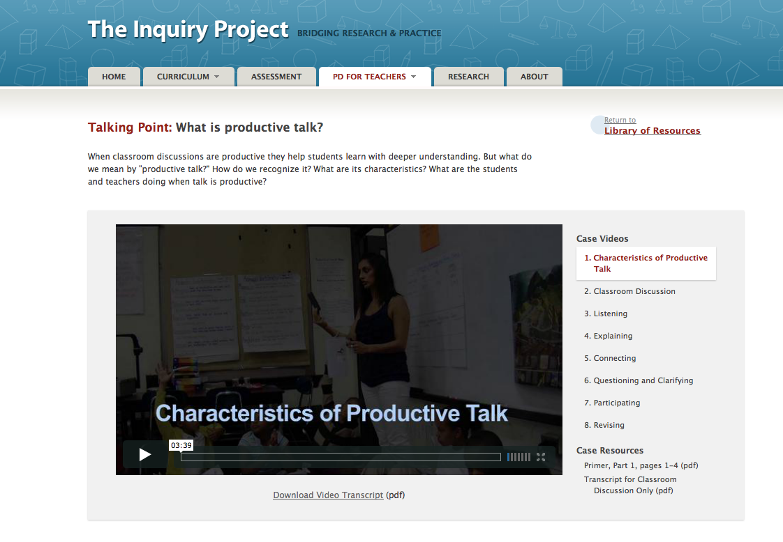
Notes:
I’m going to show a video of some fourth graders, as part of a web-based video case that explores just this: What is productive talk in science? But to give you some context, I’ll first play a a brief introductory clip -- also on the web, available to anyone at anytime, followed by the classroom discussion, from a fourth grade class in the Northeast. If you were using these resources, you’d also have access to a set of short discussions (between a sociolinguist and an urban teacher) talking about the characteristics they see in the video clip. But instead, we can talk about them ourselves!

Slide 39
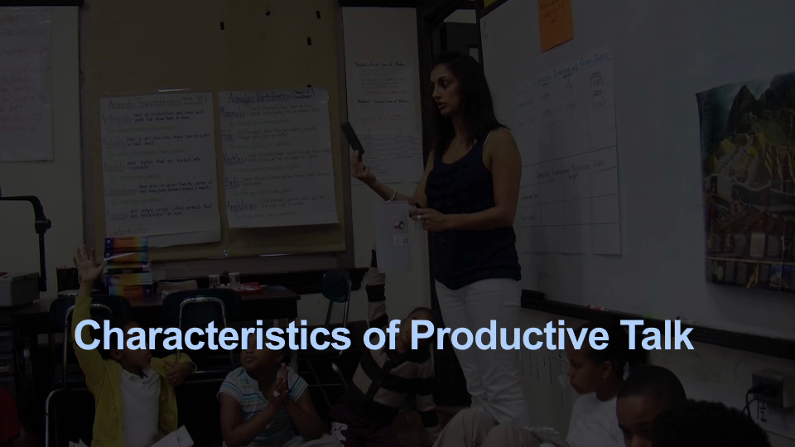

Slide 40
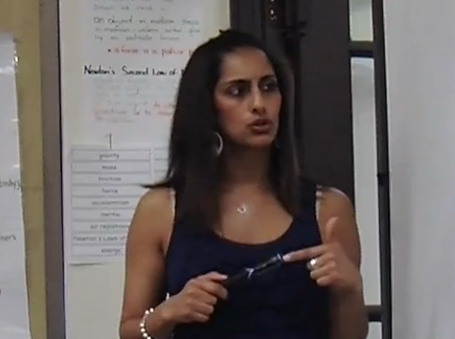
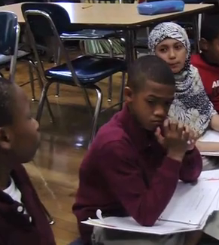
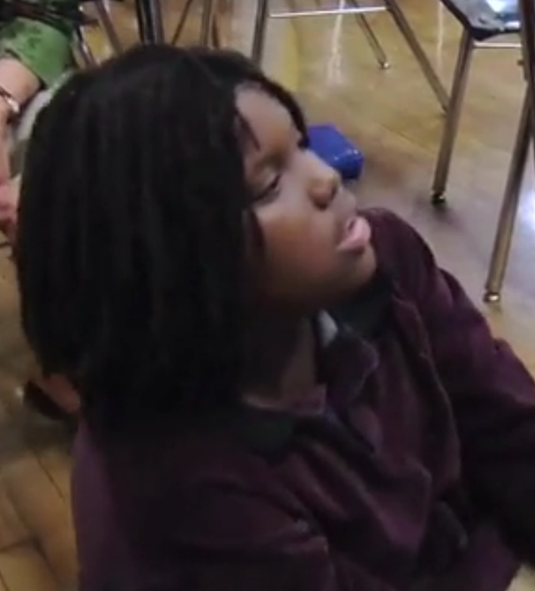
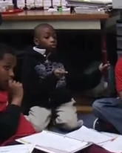
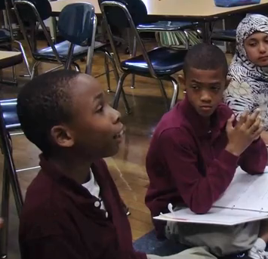
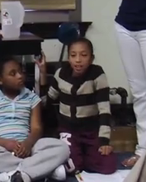
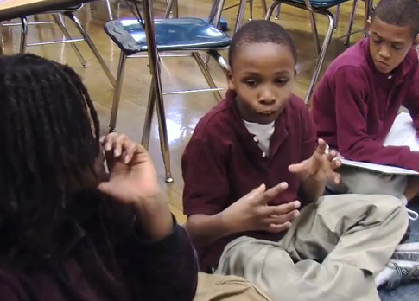
A quick preview…
Notes:
Before you see the video, it’s helpful to just preview what you’re going to see. The teacher begins with the question on the table. What makes the water level rise when you put in an object that sinks. Is it weight or volume? She reminds the kids to look at each other and really listen. Then Mathais speaks -- and he’s really, really unclear. He talks for over a minute -- and he basically says something that’s pretty complex -- he says that his group figured out that it had to be volume because when the two cubes with the same volume went in the water, the water level (which he calls “volume”) rose to the same height. So from that he concludes that it can’t be weight because they weighed different amounts and if it were weight, the levels would have been different. He’s quite inarticulate -- and hard to follow -- but he’s actually reasoning with evidence-based counterfactuals. Then Flavor agres with Mathais and proposes a thought experiment -- involving an eraser and a big cup of water. The teacher ask Javon to repeat what Flavor said and his reasoning. Then a girl disagrees with Flavor, challenging an assumption about the set-up of his thought experiment. Another girl, Aisha, poses a question to Flavor, which Flavor then responds to.

Slide 41
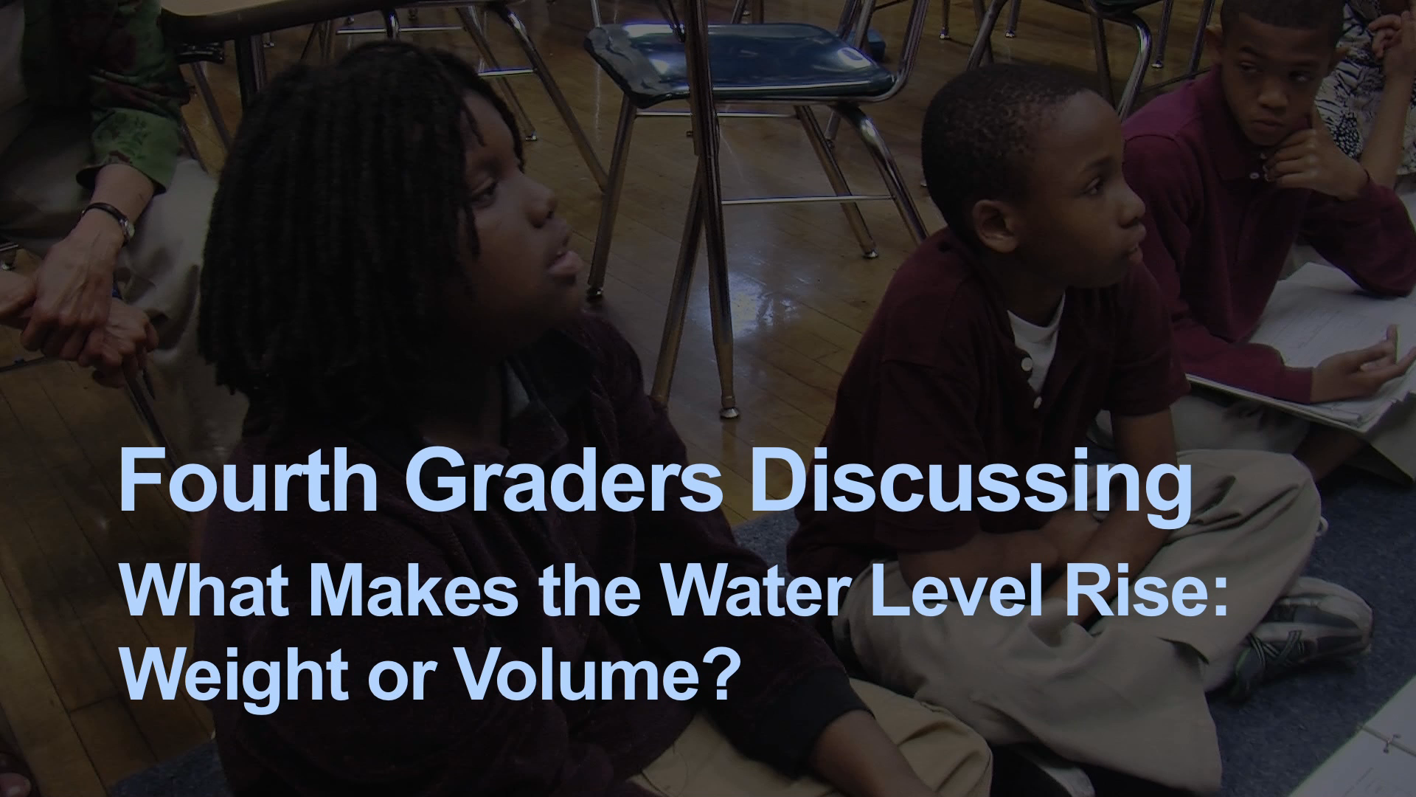

Slide 42
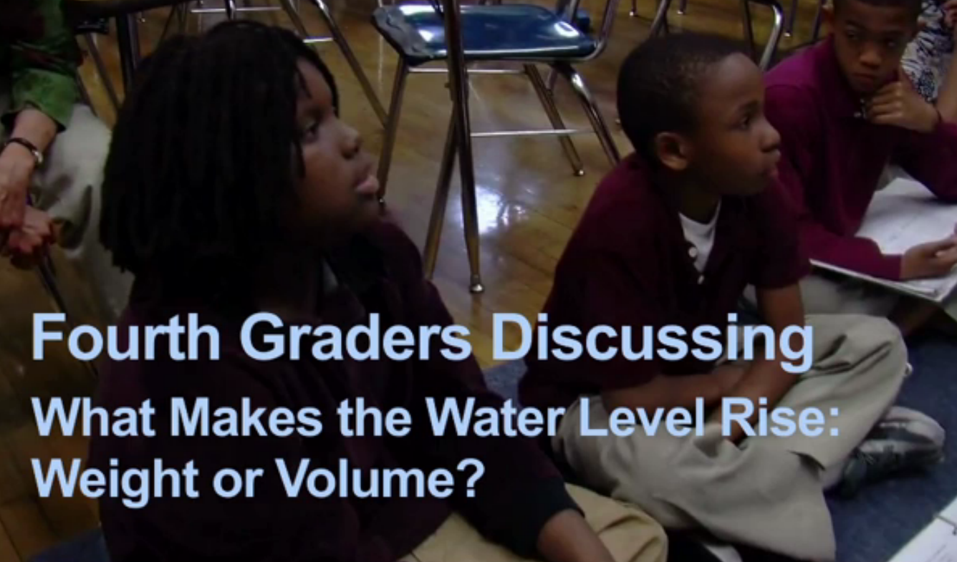
So what are you seeing?
Talk to the person next to you for 90 seconds!
What do you notice?
What characteristics do you see?
What do you notice about students?
About the teacher?
Notes:
With this group, I probably don’t need to talk about video watching norms – but the point is not to fix this teacher, but learn from what’s here.

Slide 43
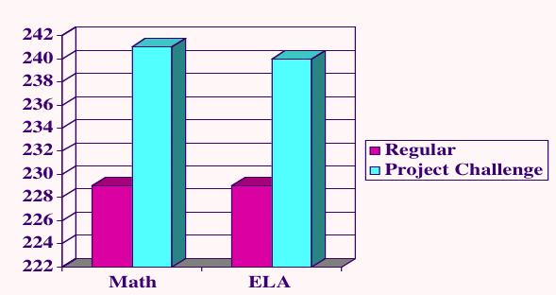
But does this work?
There is now some very clear research evidence.
Notes:
But does this work? Is there evidence that well-structured talk really promotes deep conceptual learning, and the ability to reason with others? -CLICK-
There is now some very clear research evidence.

Slide 44
Demonstrated Successes:
These well-structured discussion practices have been shown to result in robust gains in academic achievement for students from a range of socioeconomic and linguistic backgrounds.
There are a small number of carefully controlled, large-scale studies that show that well-structured talk actually “builds the mind,” with achievement gains transferring to other domains, and persisting over years.

Slide 45
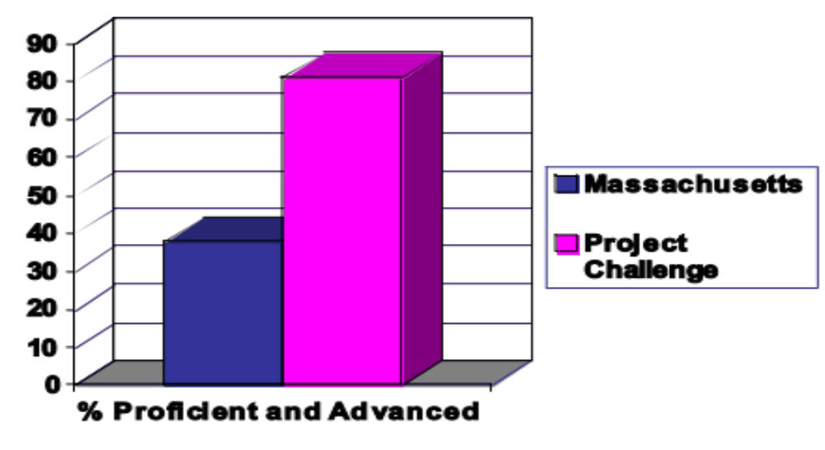
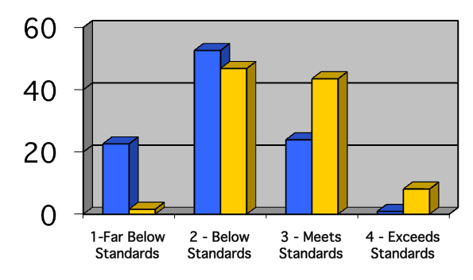
What does the research say?
Notes:
What does the research say? Let’s take a quick look at studies in all three areas -- Math, ELA, and Science.

Slide 46
Project Challenge
•4-year intervention led by Suzanne Chapin at Boston University (funded by Jacob K. Javits Foundation, US DOE)
•Purpose: to provide challenging mathematics education for middle-school students in Chelsea, MA, the lowest-performing district in the state.
Project Challenge served over 400 Chelsea students, starting in 4th grade, following through until 7th grade.
Over 70% of these students qualified for lunch aid, and over 60% spoke languages other than English at home.
Notes:
Project Challenge was a mathematics intervention in Chelsea, MA. The purpose was to provide challenging mathematics education for middle school students in Chelsea, which was, at the time, the lowest performing district in Massachusetts.

Slide 47
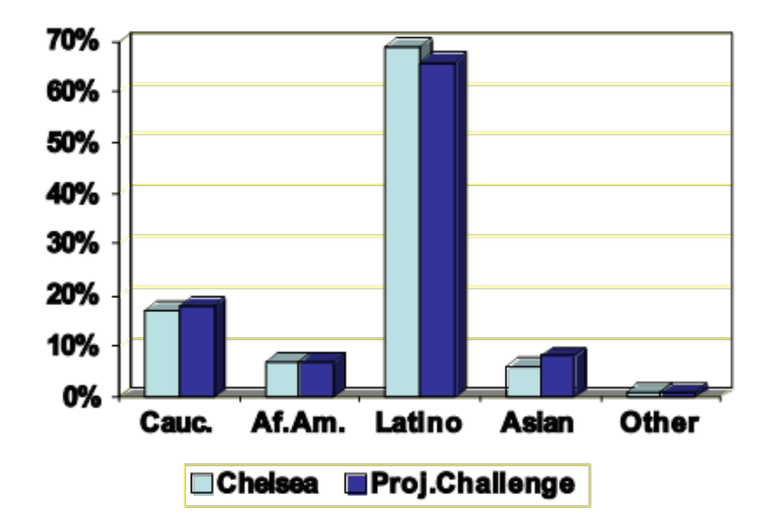
The students in Project Challenge mirrored the demographics found in the school district as a whole.

Slide 48
The intervention was multifaceted:
• One hour class every day
• TERC Investigations, Connected Math, Logic problems
• Monthly PD support for teachers, in math and around math discussions
• “Academically Productive Talk” throughout instructional practices
Results?
Notes:
The intervention was multi-faceted. They used TERC Investigations and Connected Math, and provided monthly PD for teachers. But at the heart of the program, according to the teachers, was Academically Productive Talk, or “Accountable Talk.” Through whole group discussions, with teachers using a variety of productive talk moves, previously underachieving students were supported to generate and debate potential problem solutions. –CLICK -- What were the results? There were steep changes in standardized math test scores.

Slide 49
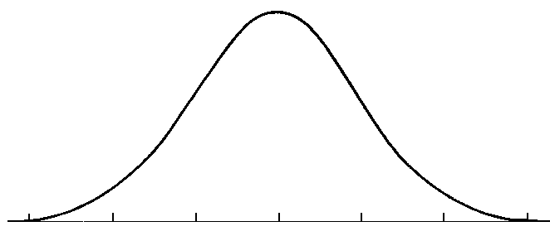
Results
In each cohort, at the end of two and a half years, the class average on the California Achievement Test math portion was at the 90th percentile of a national norming sample.
90th percentile
California Achievement Test: Computation AND Concepts
Notes:
After participating in the program for 2 years, the average score on the SAT-9 mathematics sub-tests were at the 91% (in a nationally normed sample),

Slide 50
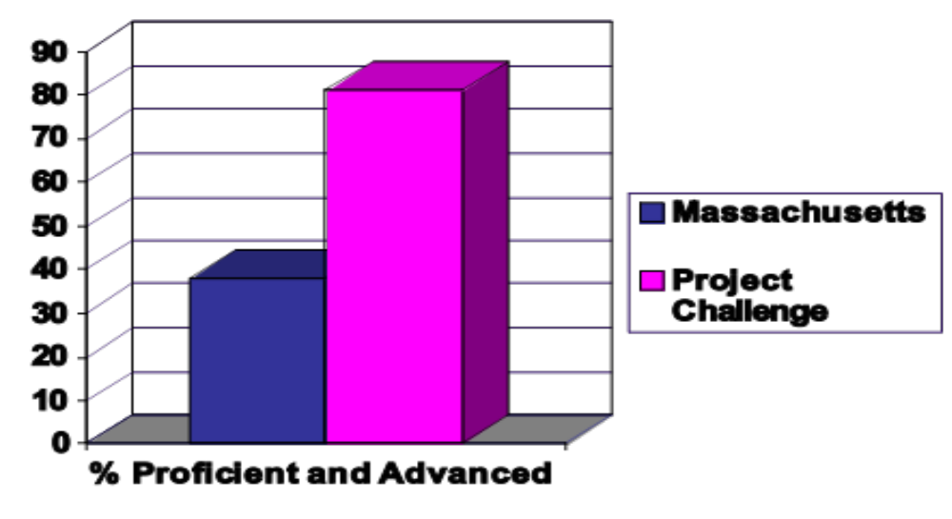
Results
At the end of three years, over 80% of each PC cohort scored as "Advanced" or "Proficient" on the MCAS math, the Massachusetts state test. (State average is 38%.)
Notes:
At the end of three years, over 80% of each PC cohort scored as "Advanced" or "Proficient" on the MCAS math, the high-stakes Massachusetts state test. (State average is 38%.) And the effect size in a post-hoc comparison study with matched controls was very large, over 1 standard deviation.

Slide 51
Results
Students made comparable gains on the ELA portion of the state MCAS test as well, even though this was a math intervention!
Notes:
And here’s the fascinating part. Students made comparable gains on the ELA portion of the state test as well. The book “Classroom Discussions” which I’ll mention later is based on this work.

Slide 52
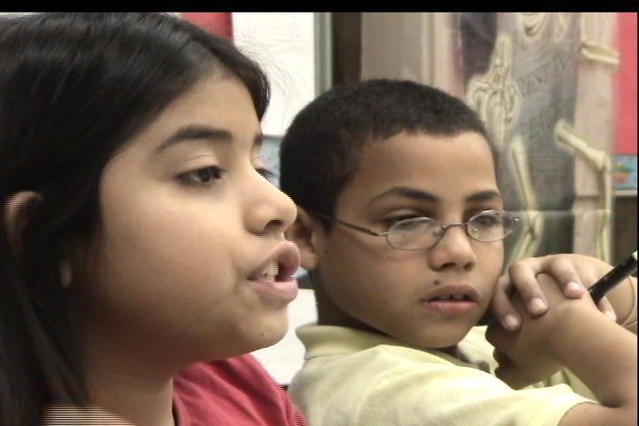
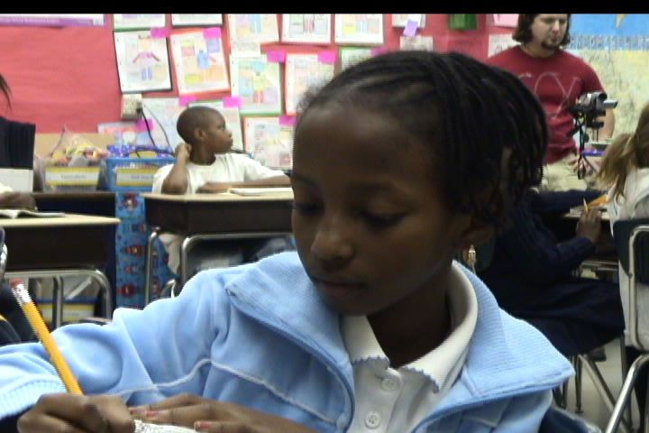
Accountable Talk and
Junior Great Books Discussions at Community School 134 in the South Bronx
Notes:
The next example comes from Community School 134 in the South Bronx. In 2003, the teachers at CS 134 began implementing an approach to reading comprehension that drew on the principles of Accountable Talk to scaffold students’ deep engagement with challenging reading texts. With support from a Comprehensive School Reform grant, the school adopted the Junior Great Books (JGB) curriculum and Shared Inquiry as the heart of the school’s Language Arts program. The specific focus of the intervention and teacher PD was on helping students learn to engage critically with challengings texts, weigh evidence, and explicate text-based arguments.

Slide 53
Community School 134
(George Bristow School)
South Bronx, New York
Population of 725 students, 99.8% free lunch eligible
  44.5% Black
  53.4% Hispanic
  9.2% English language learners
  5.9 % full time Special Ed.
Notes:
Community School 134 in the South Bronx has a student population that is 99.8% free lunch eligible.

Slide 54
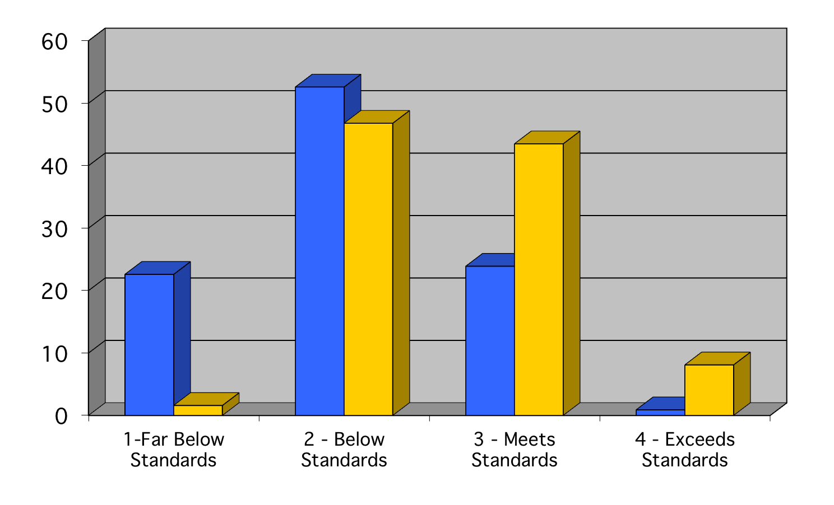
Pre- and Post-intervention scores on
NY State ELA tests
Notes:
Aside from promoting discussion and reasoning in shared inquiry, the more immediate goal was to raise test scores. CS-134 lagged even compared to other low performing schools in the district. Before the intervention, over 70% of the kids were below or far below standards. After implementing Shared Inquiry for only 6 months during the 2002-2003 academic year – CLICK -- the school’s test scores rose dramatically and these gains were maintained during the second year of the intervention, and the two years following the intervention. Unexpectedly, students’ standardized math scores at the school improved equally dramatically. This improvement earned the school special distinction in the local newspaper as the 8th most improved school in New York City.

Slide 55
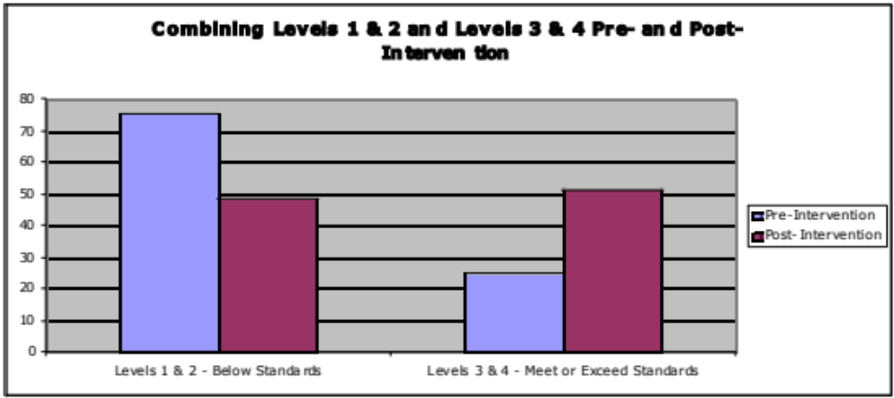
Pre- and Post-intervention scores on
NY State ELA tests
Notes:
The most important thing to note about the rise in test scores is that kids are moving out of Levels 1 and 2 (far below and below standards) and into Levels 3 and 4 (at or above standards). The history of test score rise in high poverty schools has been to move kids from failing to needs improvement (or from far below standards to below standards). It’s far more difficult to move kids out of level 2 and into proficient or meets standards. After only 6 months, the school went from over 70% below Basic, to over 50% meeting or exceeding standards.

Slide 56
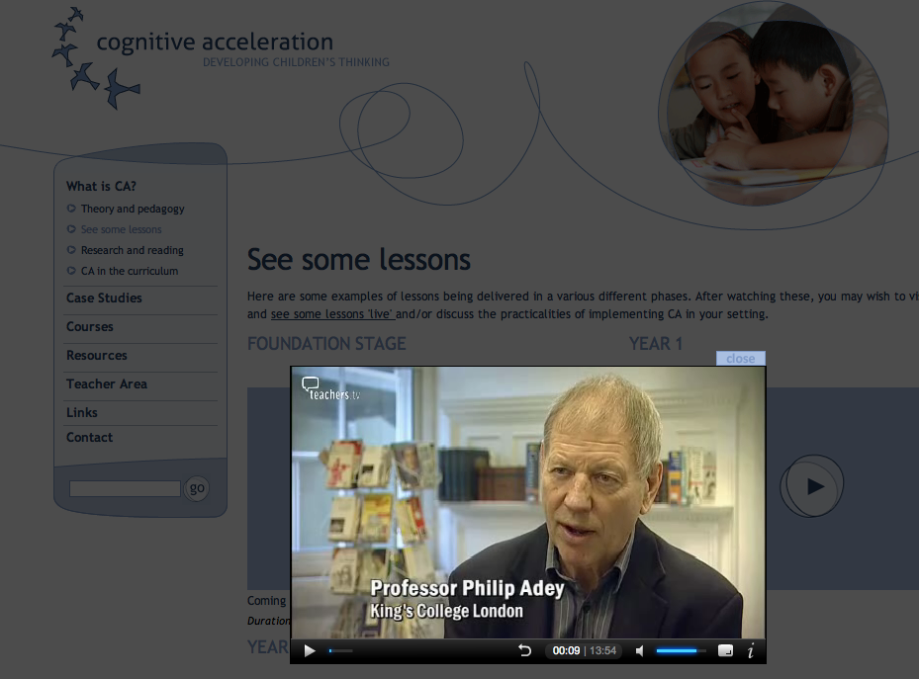
CASE (Cognitive Acceleration through Science Education)
(Adey & Shayer, 1993, 2001; Shayer, 1999, 2011)
Notes:
Now, I’m going to turn to science. In the UK, Adey & Shayer have been involved in a research and development effort, called “Cognitive Acceleration” –that spans the last 20 years. The common features of all Cognitive Acceleration programs are that they emphasize teacher-guided group discussion around rich, challenging problems.

Slide 57
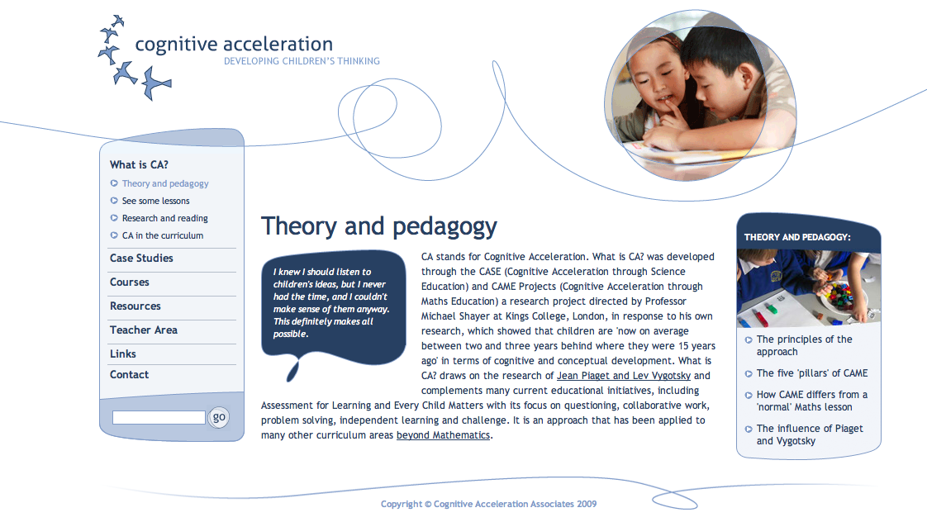
Challenge students’ thinking;
Emphasize discussion, debate, and critique;
Encourage metacognition.
Notes:
The common features of all Cognitive Acceleration programs are that they (1) challenge student’s thinking, (2) they emphasize building understanding through discussion, debate and critique and (3) the programs encourage metacognition, engaging students at the end of each lesson in reflection on how they figured out the answers they arrived at. The teacher, at the end of each lesson, says I didn’t tell you the answer you came up with today, so how did you figure it out?

Slide 58
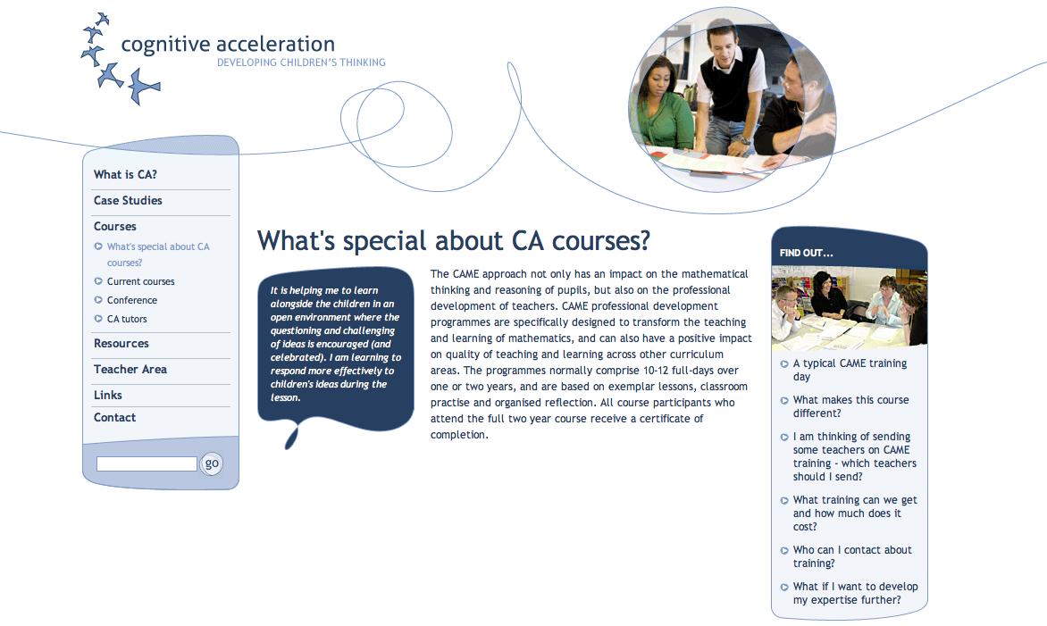
Notes:
One instantiation of their curricula, Cognitive Acceleration through Science Education, is a physics-based discussion intensive curriculum which consist of thirty 60 to 80-minute lessons used once every two weeks for two years with 12-14 year olds. Students are prompted to articulate and explain their solutions to various science problems, through whole-class discussions.

Slide 59
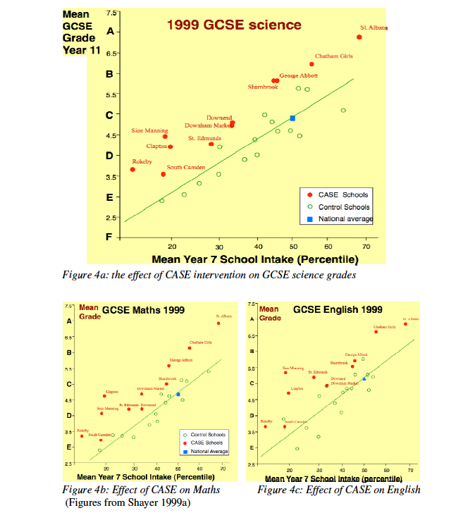
National Examination Scores of CASE Schools and Controls
Notes:
And the results are staggering. When middle school students participated for two consecutive years in this program they performed significantly better than control groups on British national achievement tests in science, taken three years after the end of the program. Moreover, they showed large differences in mathematics and English national exam scores.

Slide 60
Summing up the Research:
This body of work demonstrates that productive discussion, well-structured talk produces robust learning. It actually helps “build the mind” — with long term benefits for thinking and achievement, which show up in standardized tests, transfer to other content domains, and persist over years.
Notes:
These are not the only studies that show this kind of dramatic learning with intense focus on reasoning-based, teacher-guided discussions. I’ve provided a handout that describes this body of research and provides many citations to it. -CLICK - Taken together this work demonstrates that productive discussion, well-structured talk -- produces robust learning. It actually helps “build the mind” -- with long term benefits for thinking and achievement, which shows up in standardized tests, transfers to other content domains, and persists over years.

Slide 61
But…

Slide 62
The bad news:
While there is typically lots of talk going on in classrooms, it is often not “productive” talk.
Teachers rely on recitation
(Initiation – Response –Evaluation - the IRE) and a few reliable talkers.
Notes:
Here’s the BAD news: This kind of discussion is not happening in most classrooms, even ELA classrooms. We know from Applebee et al’s study there is an average of less than 2 minutes of discussion per hour in most ELA and social studies classes. CLICK
While there is often talk going on, it is often not “Productive Talk”. Teachers rely on recitation (Initiation --Response -- Evaluation — the IRE) and a few reliable talkers.

Slide 63
The bad news:
The dominant forms of talk in classrooms — recitation and direct instruction — do NOT support reasoning.
They do NOT support the building of arguments with evidence.
They do NOT support students to do the heavy lifting of explaining, critiquing, and building common ground.
Notes:
Let me be clear: Recitation (or quizzing) does have its place (in reviewing or checking what students remember), and so does direct instruction or benchmark lessons -- giving students access to definitions and tools. But since recitation and direct instruction are THE dominant forms of classroom talk – at every grade level, in every content domain – if we are serious about promoting the thinking practices at the heart of each of these standards documents, we are going to need a dramatic change, really a sea change – in terms of the kind of classroom talk that teachers facilitate.

Slide 64
More bad news:
Teachers are not well-prepared (from their own experiences in school) to lead academically productive, reasoning-oriented discussions.
They often rely on group work, hoping that the hands-on activities, in small groups, will teach the students what they need to learn.
Notes:
Teachers are not well-prepared (from their own experiences in school) to lead academically productive, reasoning-oriented discussions. They often rely on group work, hoping that kid-to-kid talk and the hands-on activities, in small groups, will teach the students what they need to learn It doesn’t work. This is, in my view, what has given “hands-on” or “inquiry-based” science such a bad name.

Slide 65
More bad news:
Even in good, NSF-funded science curricula, where the curriculum calls for “making meaning” discussions,
teachers have a hard time running the discussions. Discussions are often skipped. “…We just didn’t have time.”

Slide 66
The Good News:
“Reasoning” practices are common to all 3 sets of standards. Big bang for the buck.
The practices of discussion transfer from one content domain to another.
We now know a great deal about how to induct students, from all backgrounds, into these reasoning practices, through rigorous, content-rich, teacher-guided discussions.
Notes:
First, these “reasoning” practices are common to all 3 sets of standards, and at the core. So where every you work on helping teachers do this, you get a big bang for the buck.
That’s because, In order to be inducted into evidence-based reasoning or “thinking” practices, students have to be guided to participate in them, in similar ways, across the subject domains. -CLICK -The practices of discussion transfer from one content domain to another. Finally, and most significant of all, we now know a great deal about how to induct students, from all backgrounds, into these reasoning practices, through rigorous, content-rich, teacher-guided discussions.

Slide 67
We have made significant progress in helping teachers orchestrate discussion and writing activities in the service of “making thinking visible” and available.
Notes:
We’ve actually made something of a breakthrough in the last few years.

Slide 68
How to support teachers:
From research over the past decade, we have identified learnable, useful tools that help teachers orchestrate “academically productive talk.”
These tools work in all subject areas, and at all grade levels.
There are now a number of excellent PD resources (courses of study, video resources, etc.) that offer guidance in the use of these tools.
Notes:
From research over the past decade, we have identified learnable, useful tools that help teachers orchestrate “academically productive talk.” CLICK I’m not going to have time to go into these tools – talk moves and talk formats – in detail – and explore with you why they work, and why they’re so powerful –but –CLICK- but these are tools work in all subject areas, and at all grade levels.
They are now some excellent PD resources that are widely accessible, easy to implement, and cost-effective.

Slide 69
In the past …
We’ve told teachers to:
ask higher-order questions,
use Bloom’s taxonomy,
refrain from “known-answer” or “test questions,”
step to the side and get the students to talk to one another.

Slide 70
It turns out that…
None of these “rules of thumb” is at the right level for teachers — on the fly.
What they need are moment-to-moment moves to help students externalize, clarify, and extend their own reasoning, and to build on and critique the thinking of others.

Slide 71
Here’s where there’s been a breakthrough — in creating scaleable, cost-effective “visible” ways to make these talk tools accessible and useable by teachers.
The result is that teachers can pick up these talk tools, practice using them, and see rapid and robust changes in the quality of student thinking.

Slide 72
State-of-the-art PD with teachers:
Three elements:
1. A simple framework of shared goals for thinking, and discussion tools
  2. Challenging, coherent content
  3. Collections of classroom videos with real teachers and students demonstrating extended talk in relevant content areas
Notes:
State of the art work with teachers combines three things:

Slide 73
State-of-the-art PD with teachers:
Three elements:
1. A simple framework of shared goals for thinking, and discussion tools
  2. Challenging, coherent content
  3. Collections of classroom videos with real teachers and students demonstrating extended talk in relevant content areas
Notes:
State of the art work with teachers combines three things:
1) A framework of shared goals that the tools can serve. Tools make sense only with respect to the problems they help solve, and with respect to the other tools in the tool kit. CLICK

Slide 74
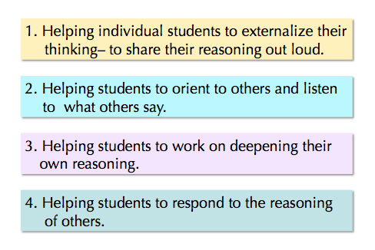
Goals for Thinking and Discussion:
Notes:
Here the goals of helping kids externalize their thinking, listen carefully to others, dig deeper into evidence and reasoning, and think with others – These goals make great intuitive sense to teachers, and has become a useful framework in this work.

Slide 75
State-of-the-art PD with teachers:
Three elements:
1. A simple framework of shared goals for thinking, and discussion tools
  2. Challenging, coherent content
  3. Collections of classroom videos with real teachers and students demonstrating extended talk in relevant content areas
Notes:
The second of the three elements:
There has to be an integration of the tools with content (this is absolutely critical -- and challenging because every lesson is different. You cannot think about or learn about talk -- in the abstract. The PD itself has to be linked to deep disciplinary content. It’s necessary to practice using these tools in real disciplinary contexts where there is actual evidence which therefore can be marshaled, either more or less effectively, and in which, therefore, the quality of one’s thinking has consequences.

Slide 76
State-of-the-art PD with teachers:
Three elements:
1. A simple framework of shared goals for thinking, and discussion tools
  2. Challenging, coherent content
  3. Collections of classroom videos with real teachers and students demonstrating extended talk in relevant content areas
Notes:
3. Collections of classroom videos with real teachers and students demonstrating extended talk in relevant content areas You have to see and feel how it’s done -- when it’s done well.

Slide 77


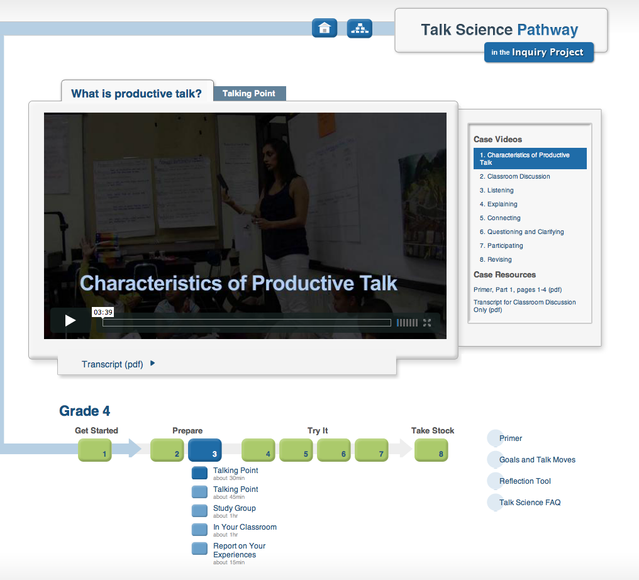
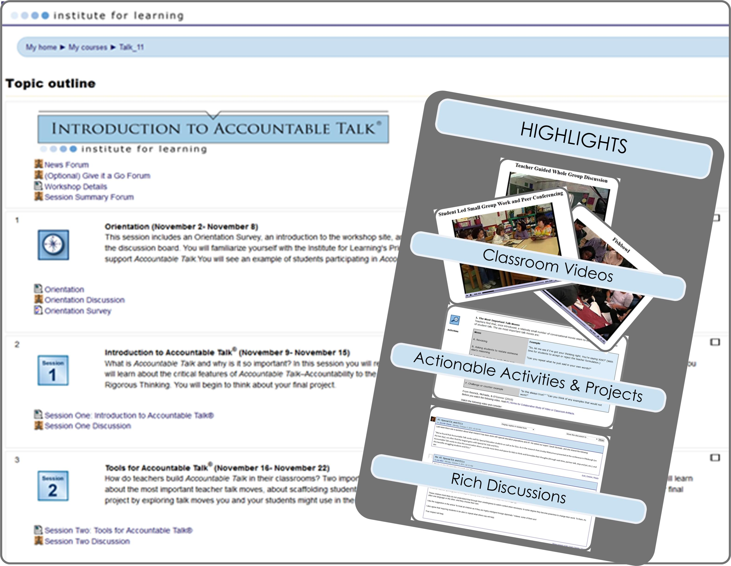
Here are some examples where talk tools are integrated into content domains:
ELA K-3
[http://discussions4learning.com]
Math K-6
[http://www.mathsolutions.com]
Math, ELA, and science, K-12
Science 3-6
[http://inquiryproject.terc.edu]
[http://ifl.lrdc.pitt.edu/ifl]
Notes:
Here are some examples where talk tools are integrated into content domains -- with support for teachers to orchestrate talk well, using classroom video and/or curriculum-embedded support.
These PD efforts work in different ways. Some require live facilitation, some don’t. Some embed the PD in specific curriculum lessons -- with just-in-tune support for teachers; some don’t. Some cost money. Some are free. But all of these programs provide effective support for teachers in learning these new discussion practices. And I’ve brought handouts and in some cases, exemplars, for each of these programs.

Slide 78


Classroom Discussions; Math K-6
Text, Videos, Facilitators’ Guide
[http://www.mathsolutions.com/MathTalk/]
Notes:
The book “Classroom Discussions,” as a study-group text, used with a – CLICK -- Facilitators Guide: Classroom Discussions: Seeing Math Discourse in Action, Grades K–6, A Multimedia Professional Learning Resource, with guidelines, discussion questions, handouts for the study group, and – CLICK -- DVDs with 5 hours of video examples from grades K-6.

Slide 79
Three different kinds of videos:
Overview clips -- what does it look like?
Illustrative Talk Moves -- What does a revoicing move look like in first grade?
Extended clips, integrating content with moves.
Notes:
Facilitators Guide: Classroom Discussions: Seeing Math Discourse in Action, has three kinds of videos.

Slide 80

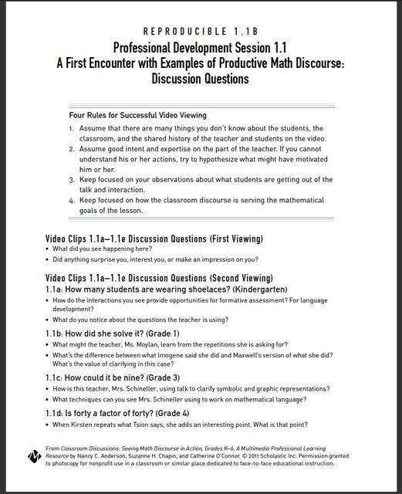
Each video clip stands alone, with no commentary, but is accompanied by guidelines for viewing norms, discussion questions, including black-lined masters, etc.
Grade 6 Video

Slide 81
IFL’s Facilitated Online Workshops
[www.instituteforlearning.org]
Notes:
The Institute for Learning offers a suite of Accountable Talk online workshops for elementary and secondary educators. The first of these, Introduction to Accountable Talk, is appropriate for all content areas and grade levels, for individual teachers or for entire departments, schools, or districts. Class size is usually about 20-25 participants.
The workshop provides an introduction to and overview of Accountable Talk. Participants learn about the relationship between Accountable Talk and student learning, teacher and student talk moves, classroom talk formats, talk norms, and teacher tools required for high-quality classroom academic talk. As a culminating project, participants design a teacher-guided student talk situation.
All workshops -- the Introduction and later discipline-focused workshops -- are facilitated by trained IFL facilitators. The heart of the learning occurs within a facilitated discussion on the discussion board. Here, participants respond to carefully constructed discussion topics and have an opportunity to reflect upon how what they are learning relates to their classroom experiences and practice.

Slide 82
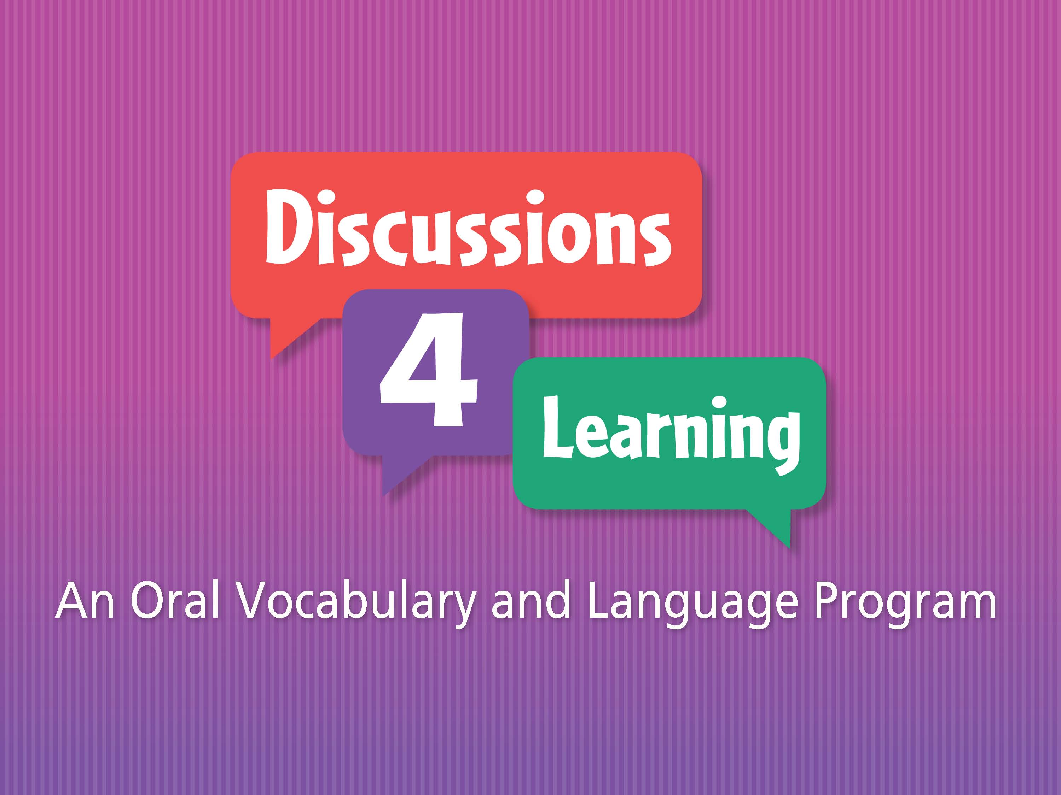
Notes:
Discussions4Learning is an oral vocabulary and language program based on digitally projected …

Slide 83

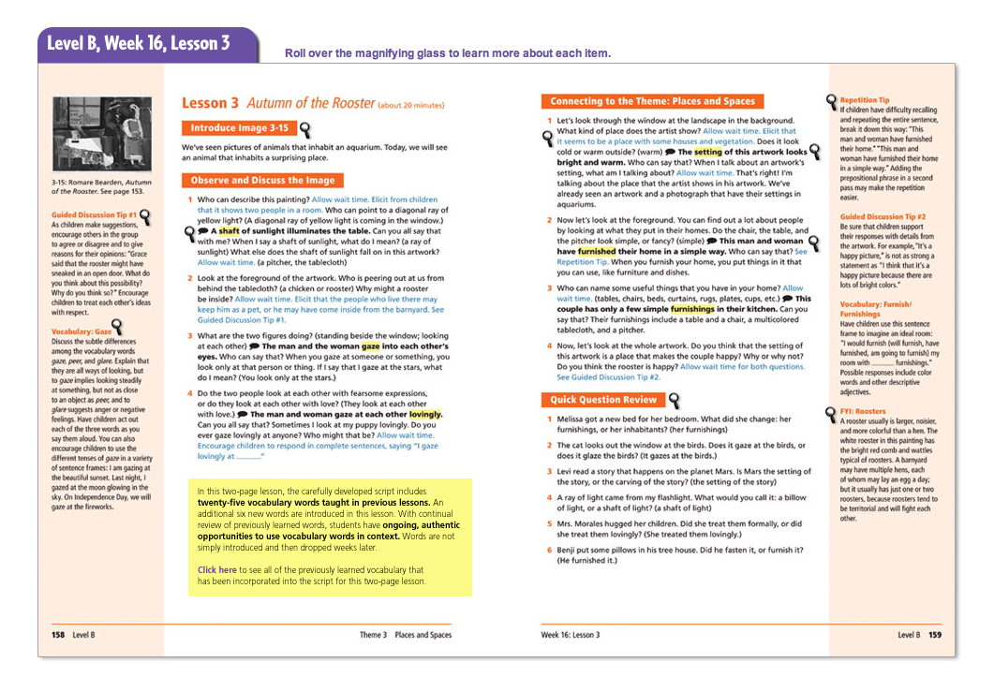
Discussions4Learning
[www.discussions4learning.com]
Notes:
fine art images and real-world photography, instead of text, to foster the norms and practices of productive discussions. Here, the teacher is displaying “Autumn of the Rooster” by the African American artist, Romare (RO-ma-ray) Bearden. Each lesson focuses on one image. – CLICK – You can see it in the top right of the teacher’s guide. What’s interesting about this is that some elements of the conversation are scripted, in terms of the way vocabulary is introduced and grounded in meaningful contexts, and there’s a lot of choral repeating -- Wow that’s a complex sentence, who thinks they can say that? Let’s all say that together, so teachers don’t have be good a fostering discussion; they’re guided into it. It supports teachers to facilitate thinking practices in discussion and opportunities for kids to acquire new rich vocabulary, use syntactic constructions that allow them to generalize, shift perspectives, use complex nominalization, and, at the same time, to focus on many of the cross-cutting themes and core ideas in the new Science Frameworks.

Slide 84

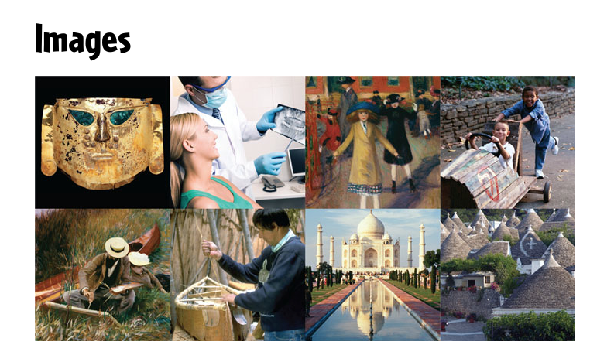
Notes:
Each lesson focuses on one image, alternating fine art images with real-world potography.

Slide 85
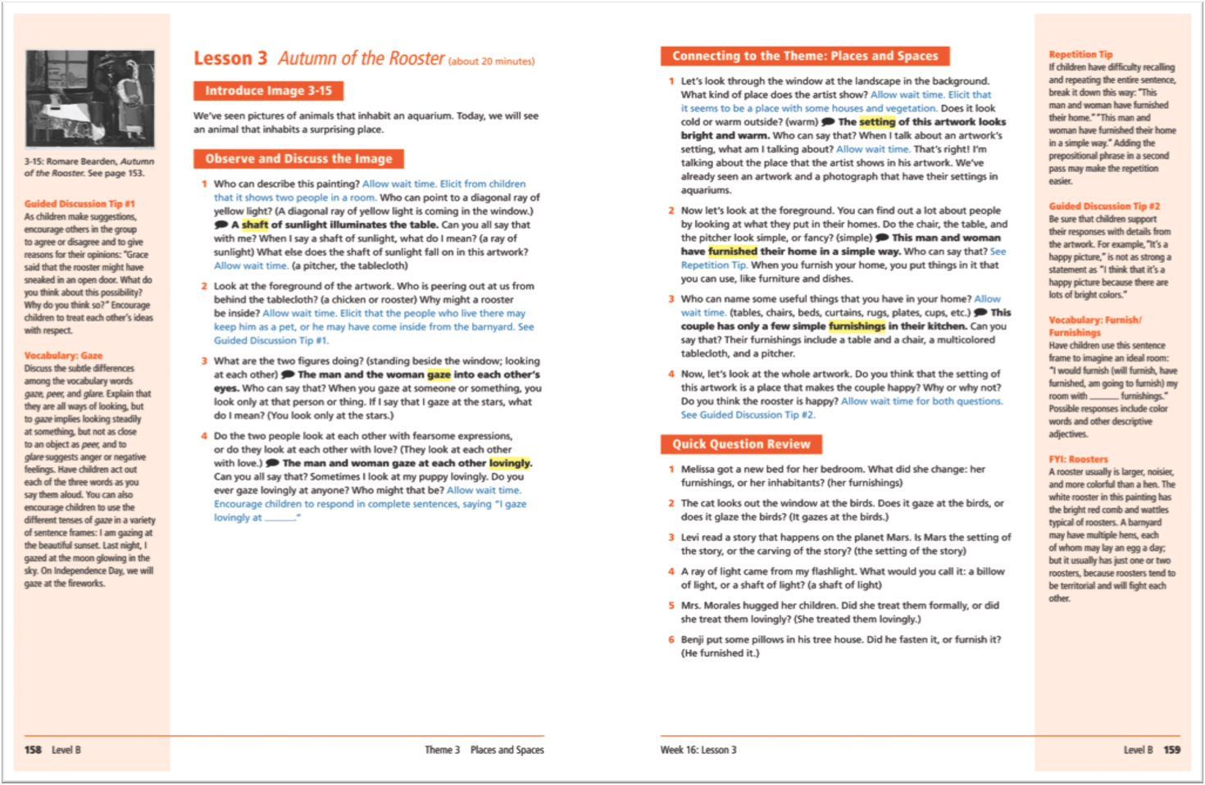
Notes:
In the teacher’s guide, the white section includes the carefully-crafted scripts. The speech bubbles indicate sentences to get everyone to repeat. But there are lots of aspects that are unscriptable. What do you notice in this image? What’s your evidence for saying that? What do you think of Jonah’s idea? The sidebars include guided discussion tips giving teachers just in time support for getting kids to do the heavy lifting in citing evidence and agreeing and disagreeing with others.

Slide 86

blossom
foliage
jungle
conceal
droop
dense
Notes:
The images include fine art from the masters (such as Renoir, Winslow Homer, Jacob Lawrence, Diego Rivera, Matisse, Chagall). I’m displaying the images with the vocabulary superimposed on the images for you to get a sense of the type of vocabulary developed with each image, but the actual program is entirely oral. In this Henri Rousseau, there’s a baboon sneaking out behind the leaves.

Slide 87
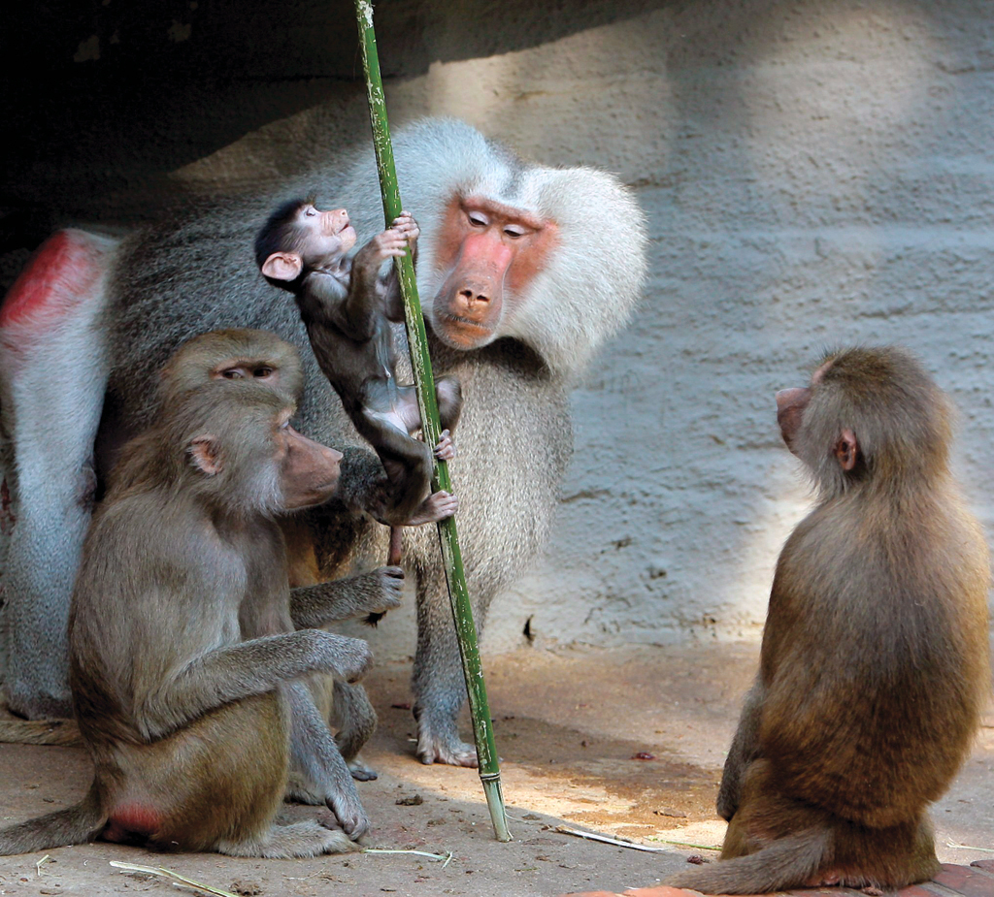
effort
pole
attempt
clutch
patient
patiently
Notes:
Followed by a real-world photograph of baboons, at a zoo in Leipzig, Germany.

Slide 88
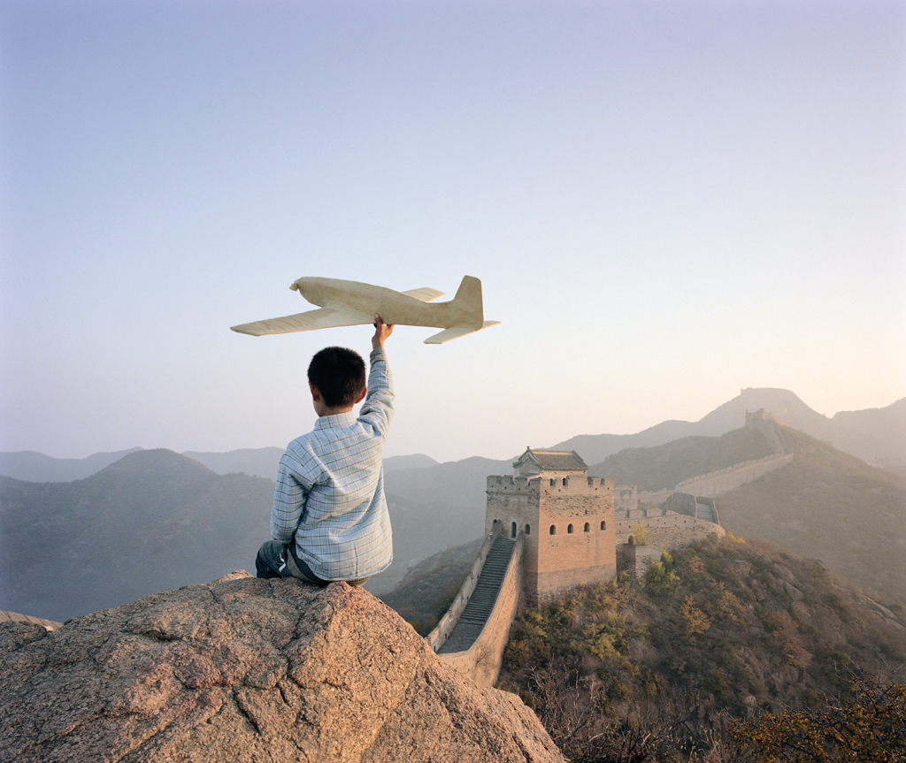
barrier
elevation
exist
ancient
contemporary
mountainous
Notes:
And here’s the Great Wall of China. It’s like bringing a world-class art museum into the classroom, and taking kids on field trips all over the world. It’s a discussion-based, early literacy curriculum, with images as shared inquiry text.

Slide 89
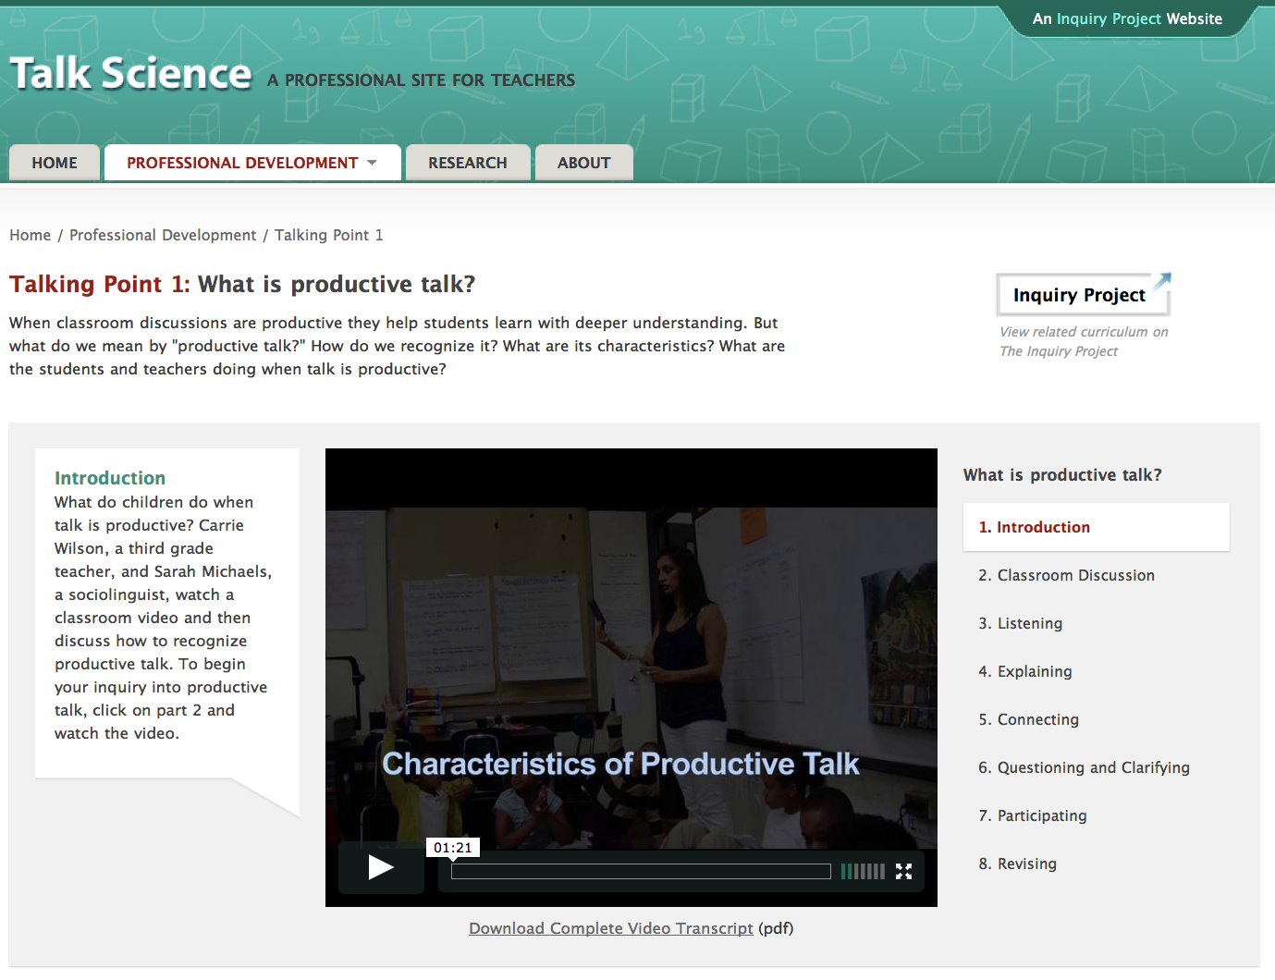
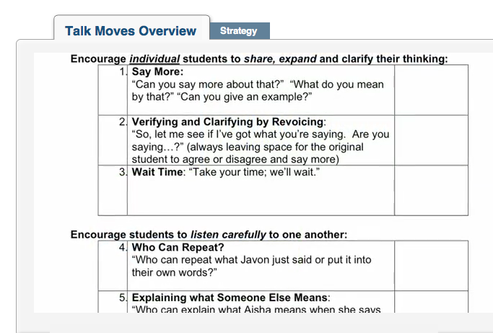
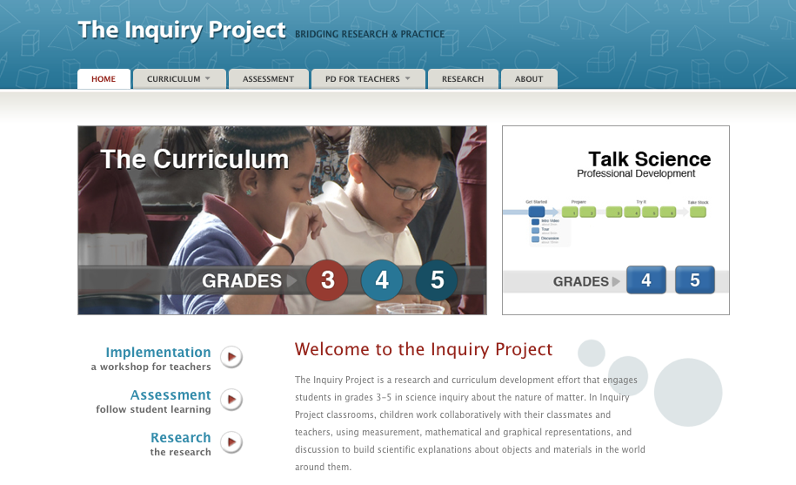
Talk Science and the Matter Curriculum:
Grades 3-5 (web-based)
[www.inquiryproject.terc.edu]
Notes:
And now to science! Talk Science is a Web-based PD site, designed for study-groups with video and text resources, but no live facilitator. --CLICK--It’s linked to the Inquiry Project Matter Curriculum for Grades 3-5, -- CLICK – designed with guidance from Marianne Wiser and Carol Smith, two of the leading scholars on learning progressions. The Inquiry Curriculum helps Grades 3-5 students to build a sound understanding of matter and material in which the physical quantities of weight, volume, and density are inter-related and for which students recognize solids, liquids, and gases as distinct forms of matter. All learning experiences are guided by the view that students’ understanding of the atomic molecular theory must rest on foundations built during the early school years and are achieved through deep and broad reconceptualizations of children’s physical, mathematical, epistemological, and symbolic knowledge. Unique characteristics of the Inquiry Matter Curriculum are it integration of math and science, and its focus on evidence-based reasoning through investigation and discussion. The entire curriculum is on the web, with teacher’s guide, student notebooks, assessment probes – available for free. I have handouts for both the Inquiry Curriculum and the embedded (“just in time”) Talk Science PD support.

Slide 90
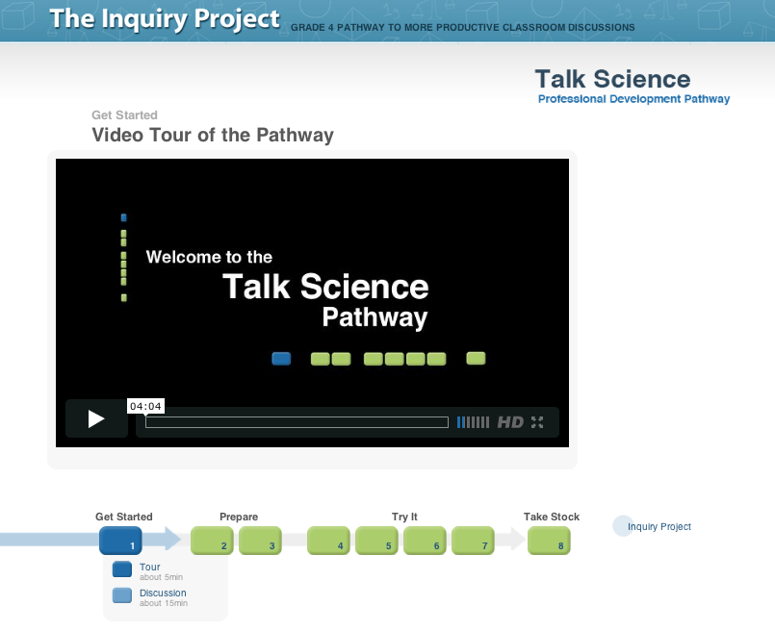
Notes:
The Inquiry curriculum site also provides a Professional Development study group pathway, CLICK, modeled on the Rosetta Stone, guiding participants to engage with videos, in sequence, that help them establish classroom norms, introduce them to talk moves, provide classroom cases, as well as scientist cases, helping them both to understand the science they are teaching more deeply, as well as learn how to facilitate productive discussions to make sense out of the hands-on science investigations. Talk Science PD is a blend of web-based study, face-to-face study group meetings, and opportunities to try out ideas in the classroom.

Slide 91
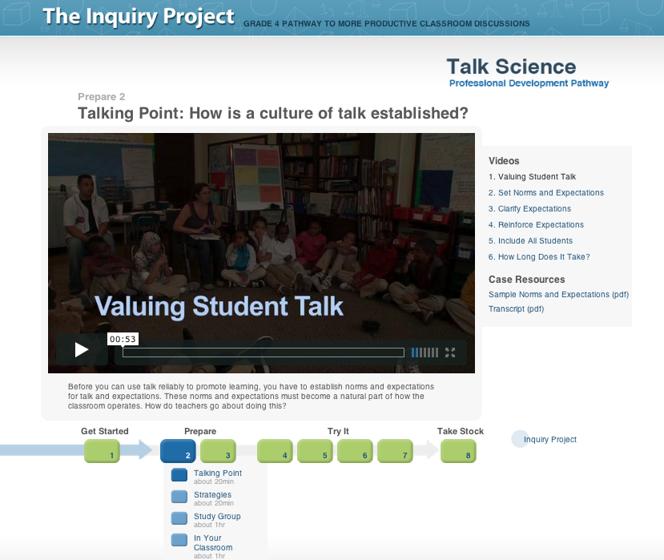
Talk Science 3-6 (web-based)
Notes:
The pathway guides participants to establish classroom norms…

Slide 92
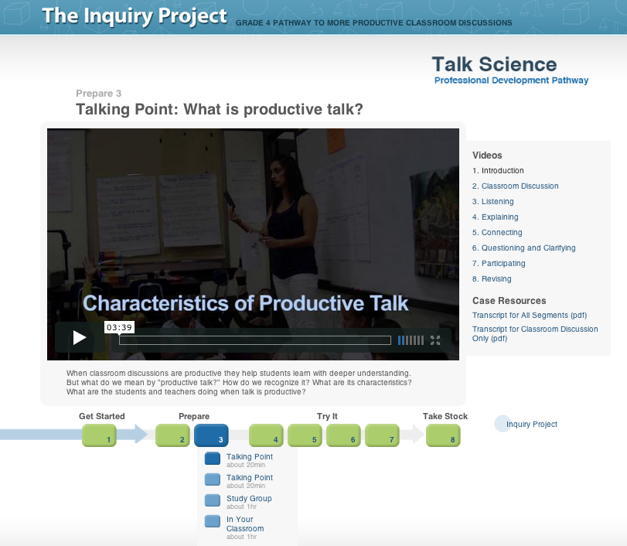
Talk Science 3-5 (web-based)
Notes:
The pathway guides participants to explore the characteristics of Productive Talk...listening, explaining, connecting, revising…within the context of classroom videos.

Slide 93
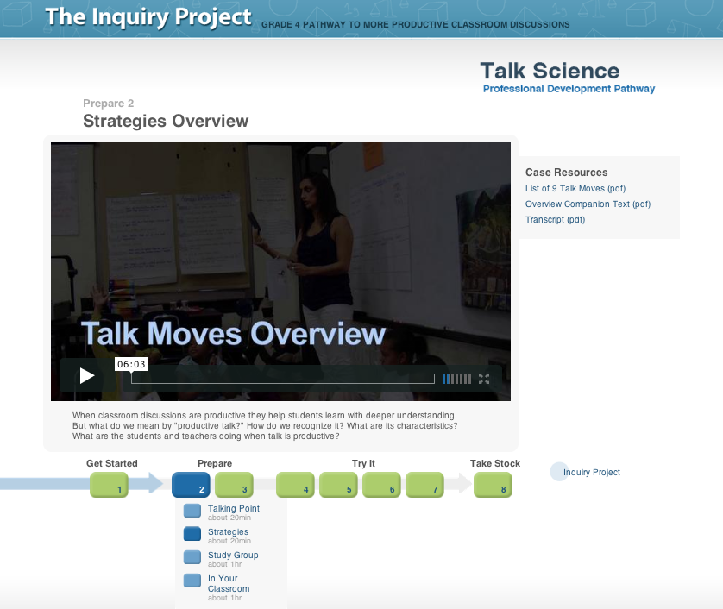
Talk Science 3-6 (web-based)
Notes:
The pathway introduces them to talk moves…with video that includes voice over commentary as well as explicated classroom clips. And this is all on the web -- really a curriculum for any science teachers, at any grade levels -- interested in thinking deeply about how to facilitate productive sensemaking discussions in science.

Slide 94
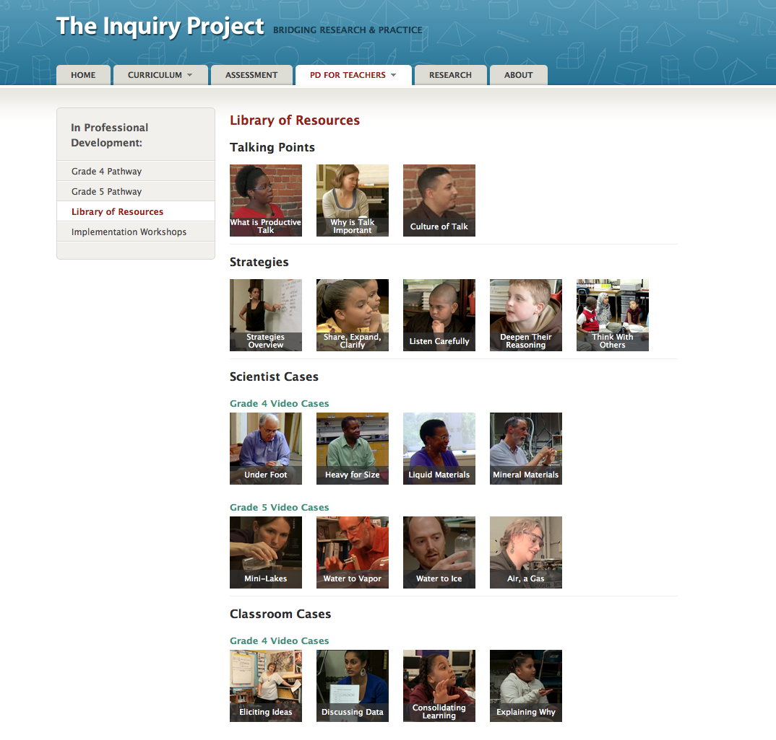
[http://tinyurl.com/Talk-Science-Resources]
Notes:
And, independent of the Matter Curriculum, what’s available is a Professional Learning “course of study” for any science teachers, at any grade level -- interested in thinking deeply about how to facilitate productive sensemaking discussions in science -- available on the web, on your iPhone or iPad, anywhere at any time. Folks at CU, Boulder have told me that they’re using it with their undergraduate and graduate student TAs in science -- to help them become better facilitators of undergraduate discussions in science.

Slide 95
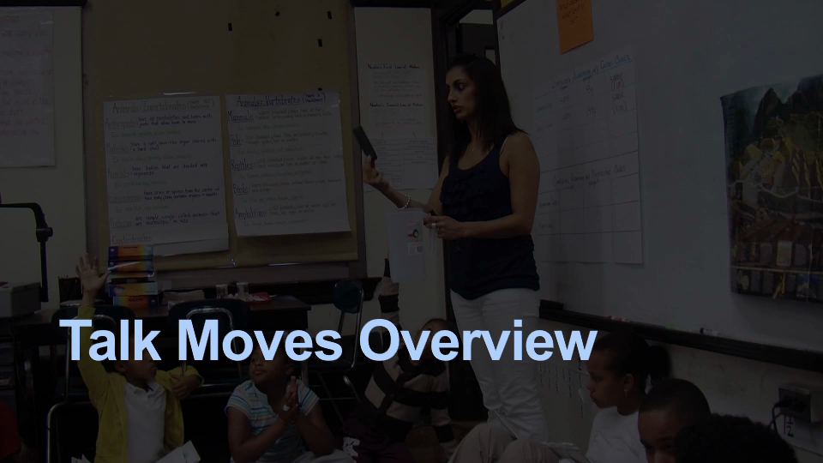
View video at Inquiry Project website
Notes:
Here’s just one example of the ways we help to make “talk moves” visible and useable -- as TOOLS that can transform the culture of talk, the mindset of the kids, and helping teachers position the kids as thinkers, so that they do more of the heavy lifting in building arguments and critiquing the arguments of their peers, with evidence.

Slide 96
Focusing teachers on talk (in PD) is a “high-leverage” practice:
In order to facilitate a productive discussion, a teacher has to think deeply about:
the disciplinary content,
the learning goals of that lesson,
the demands and affordances of the task or problem at hand, and
the students as learners, what they know or might think they know, or might need to know.
Notes:
We could talk more about the details of this web-based set of resources, but I want to bounce up a level and emphasize that … CLICk – focusing teachers on talk, productive discussion – in any domain – is what folks talk about as a “high-leverage” practice.

Slide 97
At the outset, I argued that at the core of all the new standards
— ELA, math, and now science — are specific thinking practices that arise out of productive group discussions.
Notes:
At the outset, I argued that at the heart of all the new standards — math, ELA, and science — are thinking practices that arise out of productive group discussions.

Slide 98
Why did I suggest that science educators may well be the ones to take the lead in helping teachers facilitate reasoning-based discussion?
Notes:
There are several reasons:

Slide 99
Equity
Science is fundamentally about the physical world that everyone shares. Good science teaching focuses on shared theorizable situations. This builds equity in from the start.
It is not a matter of how much you have learned at home, it is about how you reason with what’s right here — the shared problem spaces that we open up in the classroom. No one is a native speaker of physics.
Notes:
The first has to do with equity:

Slide 100
Buy-In
Science is best place to maximize the likelihood of having a good discussion because everyone is already invested in how the world works and brings well-developed “theories” and extensive embodied knowledge of the physical world.
Notes:
The second is Buy-In. Science is the best place…
And of course, the world speaks back. You can’t ignore the evidence. Authority is in the world, the evidence, not in the text or the teacher.

Slide 101
Resources
We now have better tools and resources that are accessible, for free, on the web in science — rather than in math or ELA — to support teacher development of thinking practices.
There’s plenty of science curricula, kits, etc., out there. The problem is that they are long on activity and short on thinking, and hence short on learning.
But if teachers use these talk tools to support evidence-based discussions, the curriculum and kits that they already have will become effective sites for reasoning and learning — for kids and teachers.

Slide 102
Discussion at the Center:
As opposed to math and ELA, we have the change to start fresh. Because of the pressures of NCLB, there’s very little teaching of science in elementary school. We have the chance to establish these discursive practices at the center of science teaching and learning, instead of as an add-on.
When teachers learn these new practices in science, they’ll carry them into other subject domains, just like the kids in the research I mentioned.
Notes:
So rather than fearing that science is coming late to this party, I think we should position ourselves to take the lead.

Slide 103
Thank you!
Sarah Michaels (smichaels@clarku.edu)
Cathy O’Connor
(mco@bu.edu)

