Slide 1
Research-Based Models for Professional Development William R. Penuel University of Colorado Boulder

Slide 2
Framing Our Challenge
“Alignment of teacher preparation and professional development with the vision of science education advanced in this framework is essential for eventual widespread implementation of the type of instruction that will be needed for students to achieve the standards based on it.” (NRC, 2012, p. 256)

Slide 3
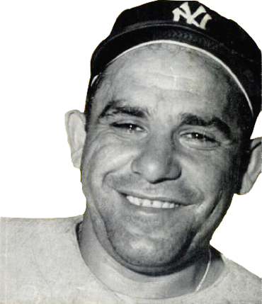
We’ve Been Here Before…
We understand that major shifts in teaching require professional development for teachers, instructional coaches, and school and district leaders.
We understand that teacher preparation programs will need to strengthen and align their focus on a new vision for student learning.
It’s déjà vu all over again.
Notes:
Only a third of teachers had PD that involved looking at student work together.
But assessment is a strong focus within half of the PD experiences, according to Banilower et al

Slide 4
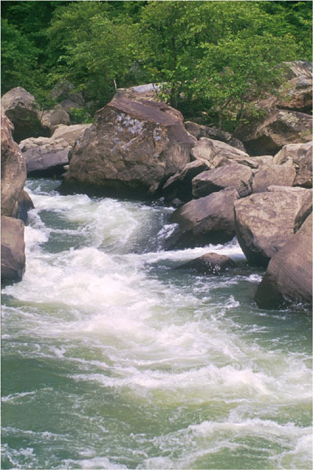
…You Can’t Step into the Same River Twice
The shifts we are asking teachers to make are from inquiry to 3D science learning.
The landscape of teacher preparation, induction, and retention is different.
Large public investments in new science curriculum and assessments are unlikely in the near future.
Our student population is becoming ever more diverse.

Slide 5
Take Home
Since 1996, we’ve learned a lot from research about professional development in science from well-designed studies.
We will all need to be creative in how we apply that research to design, implement, and sustain professional development in the Framework.
Professional development is a key strategy for promoting equity.

Slide 6
Resources
http://learndbir.org/bundles/
bcsse-denver-june-2014

Slide 7
Supporting Teaching Shifts
First Generation Standards Teacher Development Research | Potential Application for Teacher Development in the Framework
Focus on science content. | Provide teachers with opportunities to analyze the Framework disciplinary core ideas, practices, and crosscutting concepts.
Develop content knowledge by helping teachers anticipate and make productive use of students’ everyday ideas, even ones that are problematic. | Devise strategies to find out about students’ interests and everyday practices. Ask teachers to look at student work (not charts of data) together to identify different kinds of learning needs.

Slide 8
Supporting Teaching Shifts
First Generation Standards Teacher Development Research | Potential Application for Teacher Development in the Framework
Focus on science content. | Provide teachers with opportunities to analyze the Framework disciplinary core ideas, practices, and crosscutting concepts.
Develop content knowledge by helping teachers anticipate and make productive use of students’ everyday ideas, even ones that are problematic. | Devise strategies to find out about students’ interests and everyday practices. Ask teachers to look at student work (not charts of data) together to identify different kinds of learning needs.
Connecting to students’ interests and experiences

Slide 9
Supporting Teaching Shifts
Developing Evidence Statements for DCIs, Practices, and Crosscutting Concepts
Provides an opportunity for teachers to discuss and make sense of shifts in the Framework
Highlights differences and provides opportunities for developing shared meanings in a teacher community

Slide 10
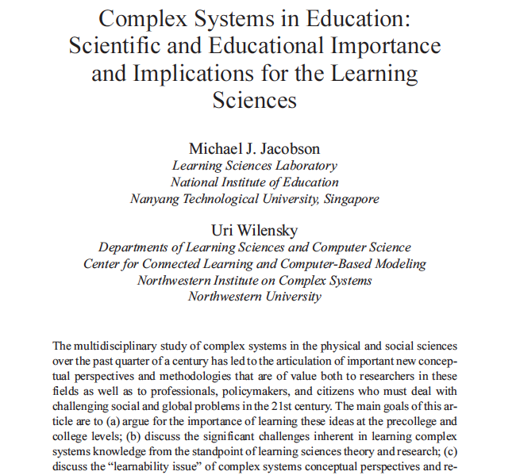
Supporting Teaching Shifts
Unpacking DCIs, Practices, and Crosscutting Concepts
Provides an opportunity for teachers to discuss and make sense of shifts in the Framework
Highlights differences and provides opportunities for developing shared meanings in a teacher community
Research on learning is relevant to activity of unpacking.

Slide 11
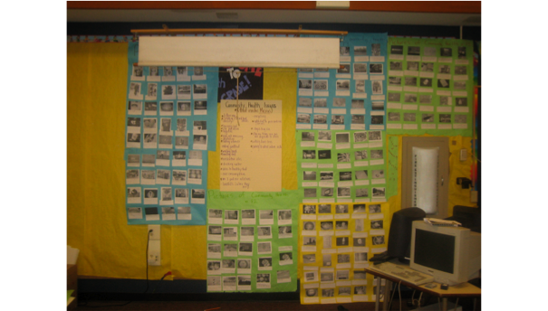
Supporting Teaching Shifts
Micros & Me: Exploring personally consequential biology
Use technique of photo-elicitation to bring young people’s everyday practices into the classroom: What do you do to stay healthy and protect yourself from disease?
Students’ responses become basis for their own questions in the unit

Slide 12
Preparation, Induction, & Retention
First Generation Standards Teacher Development Research | Potential Application for Teacher Development in the Framework
Focus on science content. | Place strong emphasis on undergraduate research opportunities and internships in science.
Focus on “high-leverage practices” for teachers to help new teachers build a strong foundation for their teaching practice. | Link practices like setting classroom norms and orchestration of classroom talk to specific science practices.
Provide regular constructive feedback on teaching from observations to build relationship between principal and teacher. | Support principals with maps that show links between teacher evaluation schemes (e.g., Danielson Framework) and Framework-aligned teaching.

Slide 13
Preparation, Induction, & Retention
First Generation Standards Teacher Development Research | Potential Application for Teacher Development in the Framework
Focus on science content. | Place strong emphasis on undergraduate research opportunities and internships in science.
Focus on “high-leverage practices” for teachers to help new teachers build a strong foundation for their teaching practice. | Link practices like setting classroom norms and orchestration of classroom talk to specific science practices.
Provide regular constructive feedback on teaching from observations to build relationship between principal and teacher. | Support principals with maps that show links between teacher evaluation schemes (e.g., Danielson Framework) and Framework-aligned teaching.
Promoting Equity, Science is a Social Enterprise

Slide 14
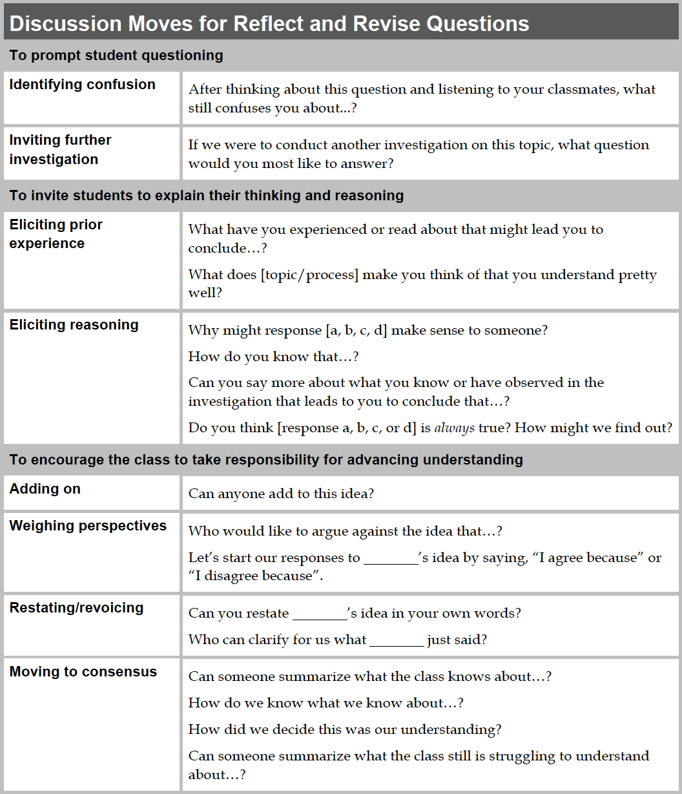
Preparation, Induction, & Retention
Contingent Pedagogies: Supporting a “high-leverage practice” (orchestrating discussion) in science
Anchored in specific disciplinary core ideas
Supports practice of argumentation with evidence
Provides additional resources for teaching that engage students in developing and using models

Slide 15
Preparation, Induction, & Retention
Efficacy Study of PBIS Curriculum: Large-scale study of a middle-school science curriculum that included PD in Framework and NGSS
State implemented new framework for teacher evaluation during the study
Study team provided teachers and principals with a “look-fors” document highlighting connections between Framework-aligned teaching and the state framework for observation

Slide 16
Curriculum and Assessment Design
First Generation Standards Teacher Development Research | Potential Application for Teacher Development in the Framework
The process of designing and adapting curriculum materials—when supported by subject matter and curriculum experts—can be a powerful form of professional development. | Design curriculum adaptation activities to build in support for teacher learning about the Framework and instructional models congruent with NGSS.
Formative assessment can be an effective focus of professional development when it helps teachers elicit, interpret, and make use of information about student thinking. | Support teachers in analyzing assessments for evidence of development of student thinking over time.
Notes:
Engaging teachers in the design and adaptation of curriculum materials is a form of “active learning” in which teachers can effectively explore the materials through practice, investigation, problem solving, and discussion (Banilower et al., 2006). Developing materials provides a way for teachers to match instructional materials to student needs (Huffman, Thomas, & Lawrenz, 2003). Engaging teachers in design and adaptation of materials provides a way for teachers to learn about theories from research they can apply to practice (Parke & Coble, 1997). Teachers who begin with strong models of curriculum materials provide students with higher quality opportunities to learn (Penuel & Gallagher, 2009). Professional development that provides models for adapting materials and teaching effectively with them can produce greater student learning gains (Penuel, Gallagher, & Moorthy, 2011).

Slide 17
Curriculum and Assessment Design
iHub: A long-term partnership of Denver Public Schools, UCAR, CU Boulder, and BSCS
We work on district challenges together, applying what we know from research to develop solutions collaboratively.

Slide 18
Unit Driving Question: How will an increase in the population of trees affect ecosystems in Denver?
Phenomenon: Many cities are encouraging citizens to plant trees.
Phenomenon/Question
Engage in Practices
What Students Can Explain
Why should I care about trees?
Using mathematics and computational thinking to analyze cases of what happens when trees are removed from an ecosystem (e.g., fire, disease)
Can explain how changes in tree cover affect living and nonliving elements of an ecosystem
How do trees affect the air we breathe?
Developing and using models of the role of photosynthesis in carbon sequestering
Can explain how trees figure in the cycling of carbon in atmosphere
How many trees can we grow in Denver?
Planning and conducting investigations to develop accounts of resource needs, competition, and limiting factors on tree growth
Can explain how availability of resources and competition affect carrying capacity
What kinds of trees would provide the most benefit to the ecosystem?
Engaging in argument from evidence about species characteristics to advocate for the best type of tree is best to plant in a particular ecosystem
Can explain trade-offs in benefits of planting particular species to different organisms

Slide 19
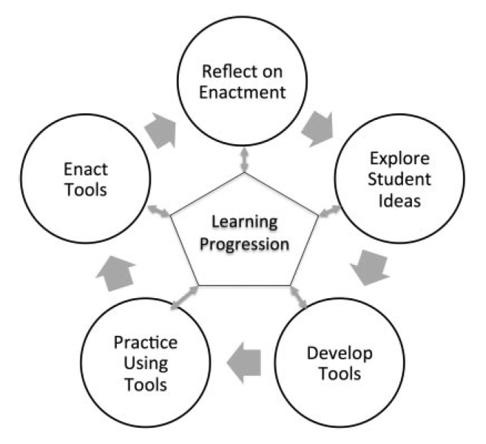
Curriculum and Assessment Design
Daphne Project: Focus on using learning progressions to design, implement, and analyze data from assessments
Key Findings
Teachers in one school used the project as an opportunity to bring previously disparate units into sync, and to develop and enact a common sequence of formative assessments within their unit
Teachers in another made limited use of the project tools, because they were not congruent with existing accountability requirements.
Notes:
Furtak, E. M., & Heredia, S. (in press). Exploring the influence of learning progressions in two teacher communities. Journal of Research in Science Teaching.
be used as underlying frameworks for curriculum materials to promote coherence and spiraling across the curriculum, or for assessments to improve their
diagnostic function. However, a smaller subset of researchers is beginning to argue that learning progressions might also be provided to teachers to serve as models for how understanding develops in a domain (Bennett, 2011; Furtak, 2012; Heritage, 2008), and therefore may be ideally suited to support teachers in designing and enacting formative assessment in their classrooms.
Researchers found that:

Slide 20
Crafting Coherence Among States
There are many professional development providers across the states, operating largely independently of one another.
An updated set of professional learning standards for science education can provide:
Foundation for a network of professional development activities to emerge that aligns with the vision of the Framework
Guidance to providers, educational leaders, and teachers regarding professional development.

Slide 21
Professional Learning Framework
An initiative of the Council of State Science Supervisors’ Professional Learning Committee
Charge of Committee:
to identify professional learning needs of CSSS members and coordinating professional learning activities that addresses these needs
to provide information to CSSS members on best professional development models being used throughout the country
to open lines of communication between in-service and pre-service providers and CSSS state members.
Committee is state-led, includes research support
Notes:
Research support: Dr. Richard Audet and myself

Slide 22
Professional Learning Framework
In an early draft form seeking your input on:
Need
Content
Models
Organization
Focus of Professional Learning
Design and Implementation of Professional Learning
Evaluate and Sustain Professional Learning
Guidance for Teachers and Policymakers

Slide 23
Table Talk

Slide 24
Thank You
Contact
Bill Penuel
william.penuel@colorado.edu
Twitter:
@bpenuel
@LearnDBIR
http://learndbir.org/bundles/
bcsse-denver-june-2014

